Slide 1

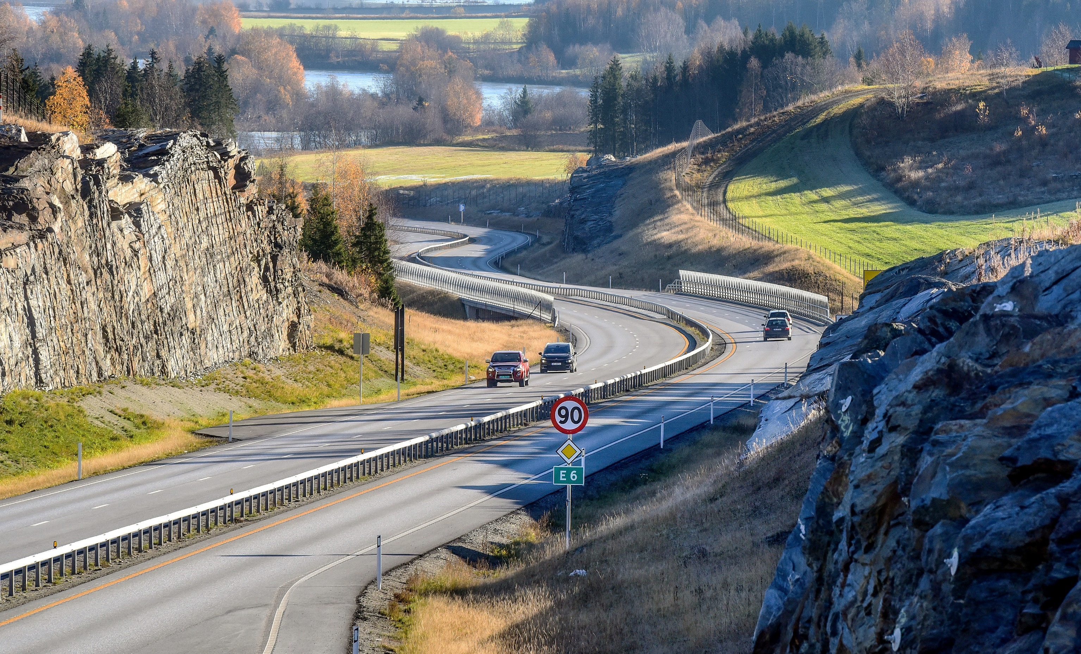

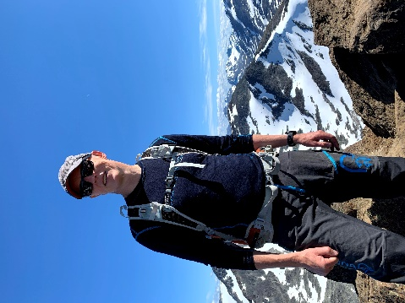
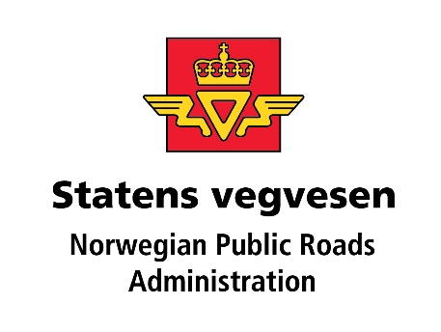
Exploration of Information Models Technologies for information modelling in Geographic Information Systems (GIS), Intelligent Transport Systems (ITS) and Building Information Modelling (BIM)
Knut Jetlund
Norwegian Public Roads Administration
Norwegian University of Science and Technology
ISO/TC 211 AG5 - HMMG
knut.jetlund@vegvesen.no
Twitter: @Jetgeo
LinkedIn: https://www.linkedin.com/in/knut-jetlund/
Photo: Knut Opeide, Statens vegvesen

Slide 2
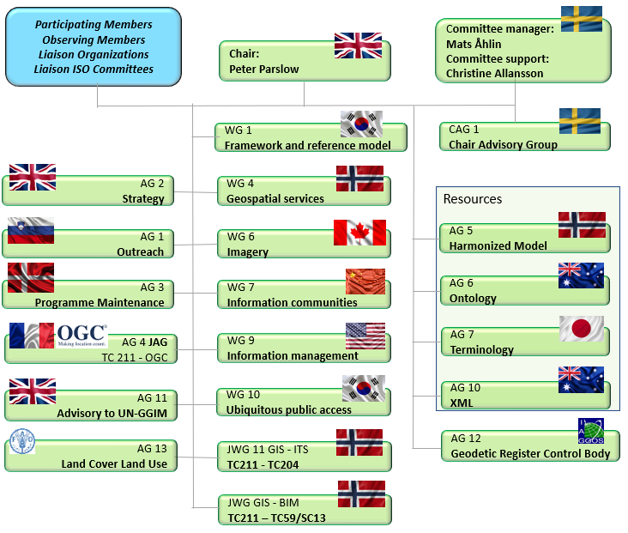
Background
https://ntnuopen.ntnu.no/ntnu-xmlui/handle/11250/2740648
https://committee.iso.org/home/tc211

Slide 3
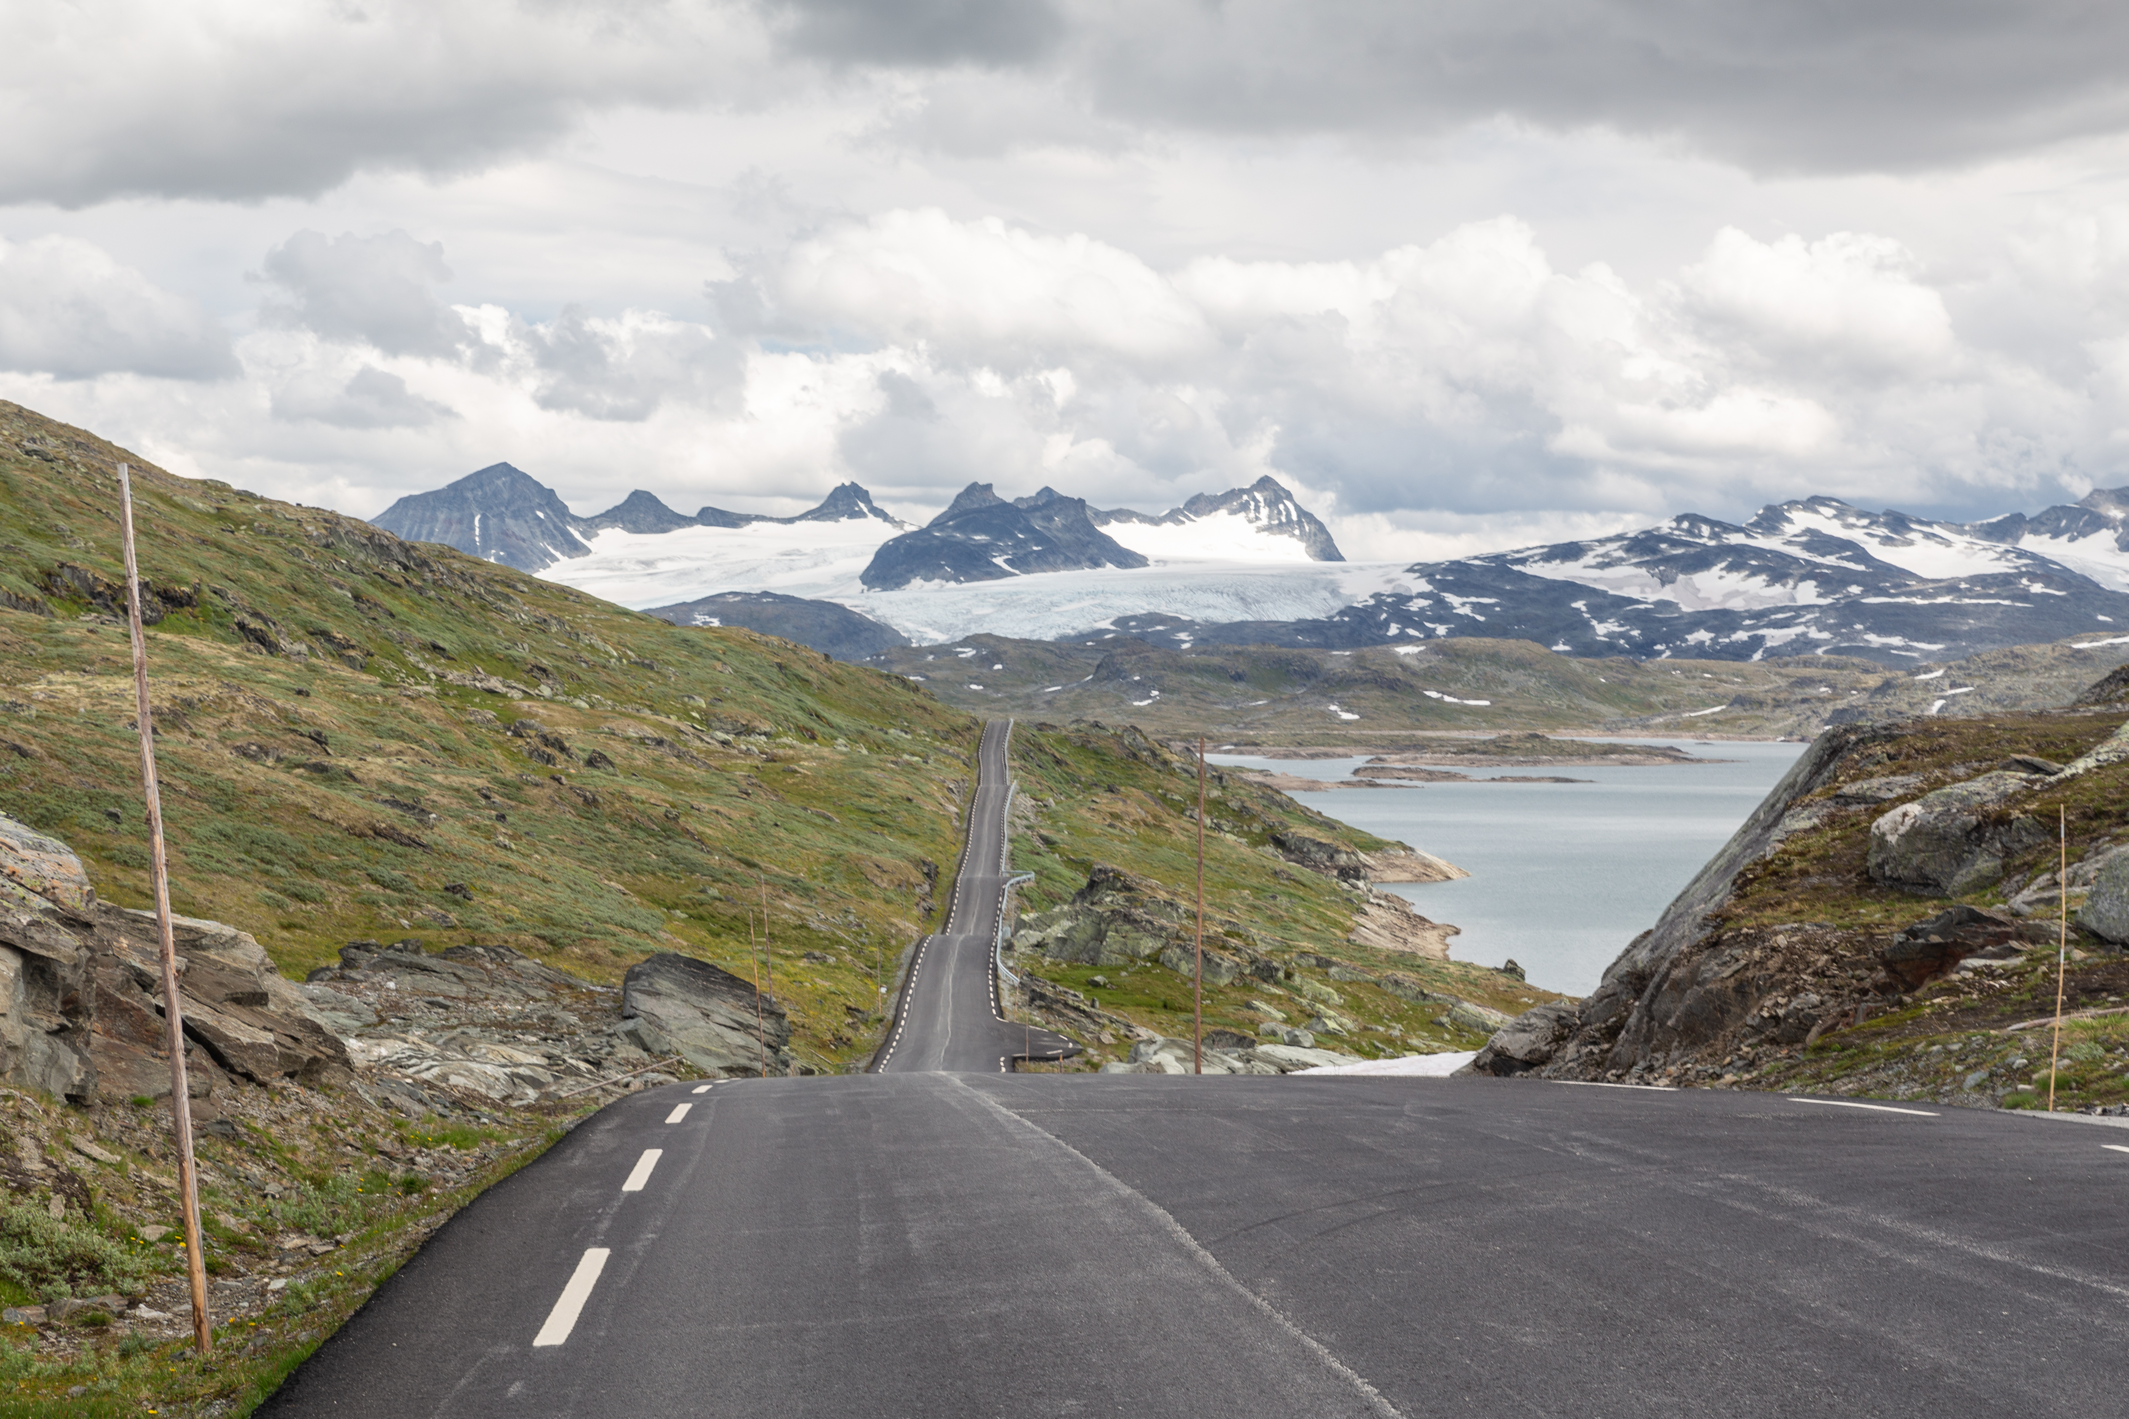
Agenda
Motivation
Theory
Phd Thesis:
Research questions
Results
ISO/TC 211 MDA
Conclusions
Questions, discussion
Photo: Knut Opeide, Statens vegvesen

Slide 4
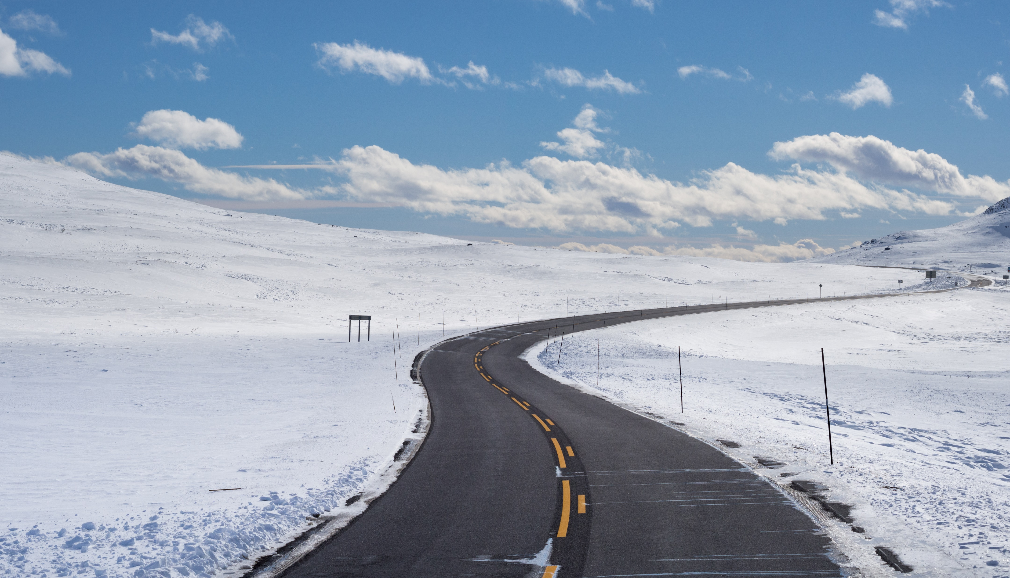
Photo: Werner Harstad, Statens vegvesen
Motivation

Slide 5
Everything happens somewhere
Geospatial information
BIM
ITS
GIS
LCA
Smart Cities
Climate
+++
78% of German Wikipedia articles in 2013 were found to be either directly or indirectly related to geospatial location references.
Source: Hahmann, S., Burghardt, D., How much information is geospatially referenced? Networks and cognition. International Journal of Geographical Information Science 2013, 27(6), p. 1171-1189,DOI: 10.1080/13658816.2012.743664.

Slide 6
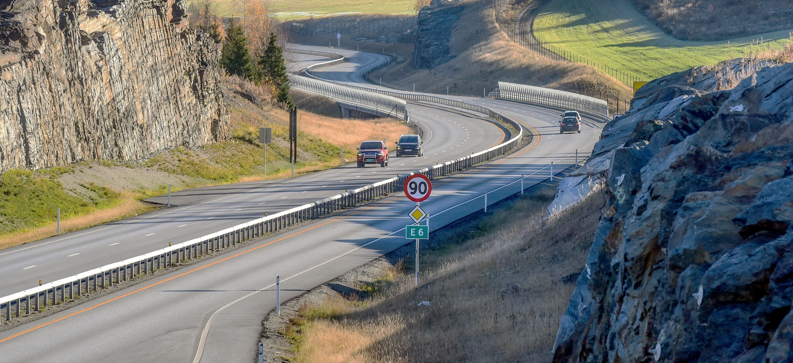
Three application domains, one real world
Photo: Knut Opeide, Statens vegvesen
Notes:
Constructions in the real world, such as features in the road infrastructure in this picture, relate to, influence and are influenced by, other features from the natural and built environment, through their location, shape and extent.
This geospatial context is vital for the representation of the natural and built environment in a digital environment as well.
During the lifecycle of the road, processes involve several application domains where the geospatial context is essential. Among these are the application domains of GIS, ITS and BIM. The three application domains have distinct, but related, roles, and handle the real world from different perspectives: Applications for GIS are mostly used for analyzing and presenting the existing natural and built environment, while applications for BIM are used for planning, developing, constructing and maintaining the built environment. Finally, applications and systems for ITS use the information about the built environment to plan and control transportation.
The three application domains work with the same physical geospatial environment, but due to the different roles, they have different views on the real world and its representation in a digital geospatial environment.

Slide 7
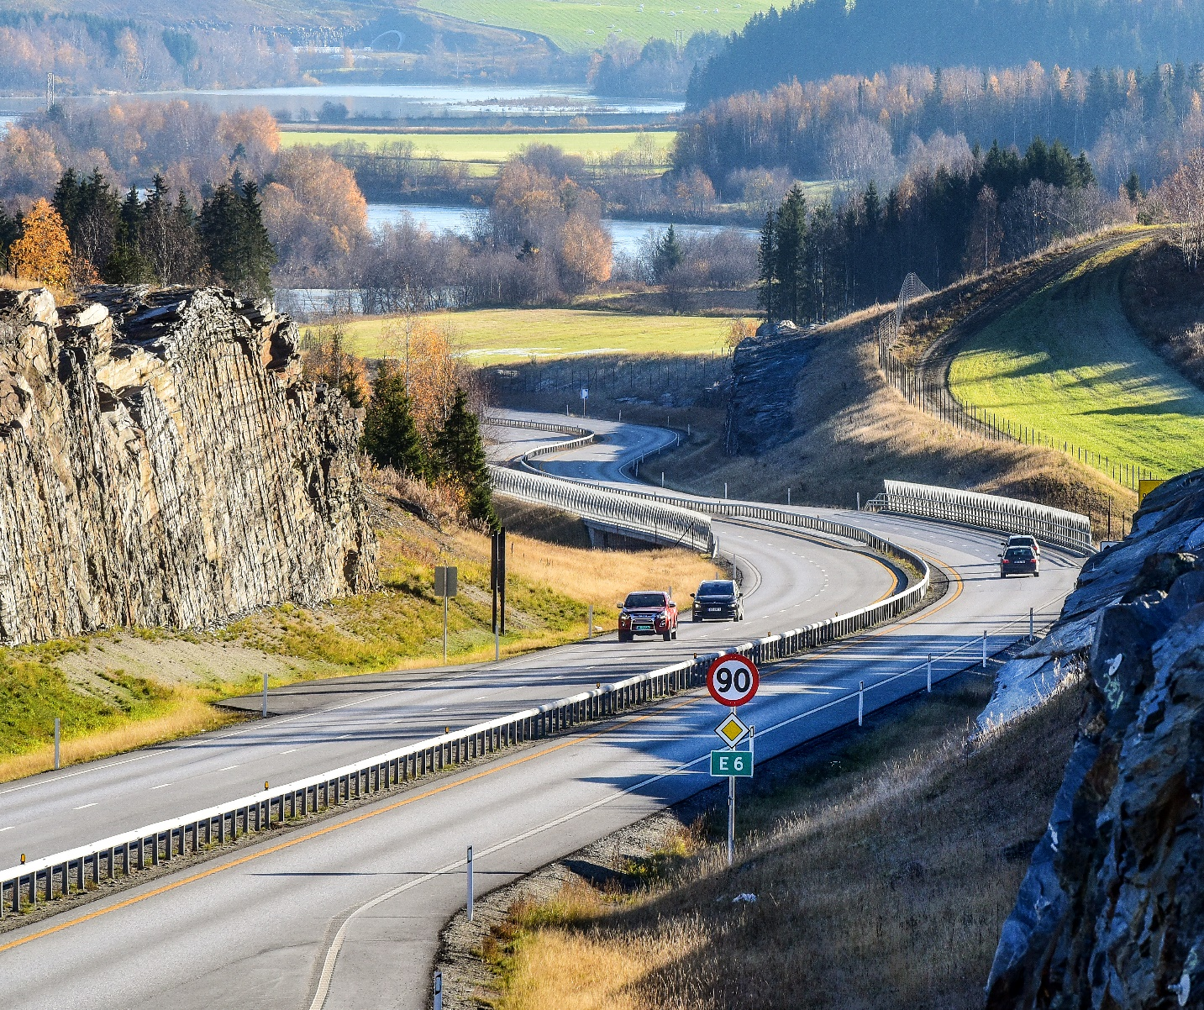
Reuse of information across domain borders
The challenge:
Reuse requires a common understanding of how the real world is described in information models
Modelling language
Terminology
Geometry and location referencing
Exchange technologies
Photo: Knut Opeide, Statens vegvesen
Notes:
While the roles of GIS, ITS and BIM are distinct, and the application domains see the real world from different perspectives, the picture shows us that many of the real-world features and concepts they handle are the same. Therefore, reuse of information across application domain borders should be possible.
Before this road was built, there was mostly a natural environment, represented in GIS data sets. The new road was planned, developed and constructed with support from BIM processes. During the construction, the road cut into and changed the existing natural and built environment and became an integrated part of a new physical environment. Therefore, the GIS data sets need to be updated with the new built environment, as well as the changed natural environment. Also, ITS applications for route planning and navigation need an updated representation of the road environment, and of restrictions for navigation, such as speed limits and forbidden manoeuvres.
Let’s use the railings in this picture as an example: The digital representation of a guardrail along a new road will begin its life in the planning stage for the road, where the railing is created in a BIM application, as a feature that shall be constructed. The feature representation of the railing should later be reused in GIS datasets, for presentation on maps, and, for example, for calculating noise pollution. Furthermore, the same railing is needed in High Definition maps for ITS as an obstacle that vehicles need to be aware of. The different domains need specific information about the feature, but they are all referring to the same real-world phenomenon.
The challenge we face in the exchange and reuse of information is that the different application domains have developed information models with their specific interpretation of the real world. In order to understand information across domain borders, we need a common understanding of how the real world is described in information models. This concerns the modelling languages that are used, the terminology, how geometry and location references are described, and the exchange technologies that are used.

Slide 8
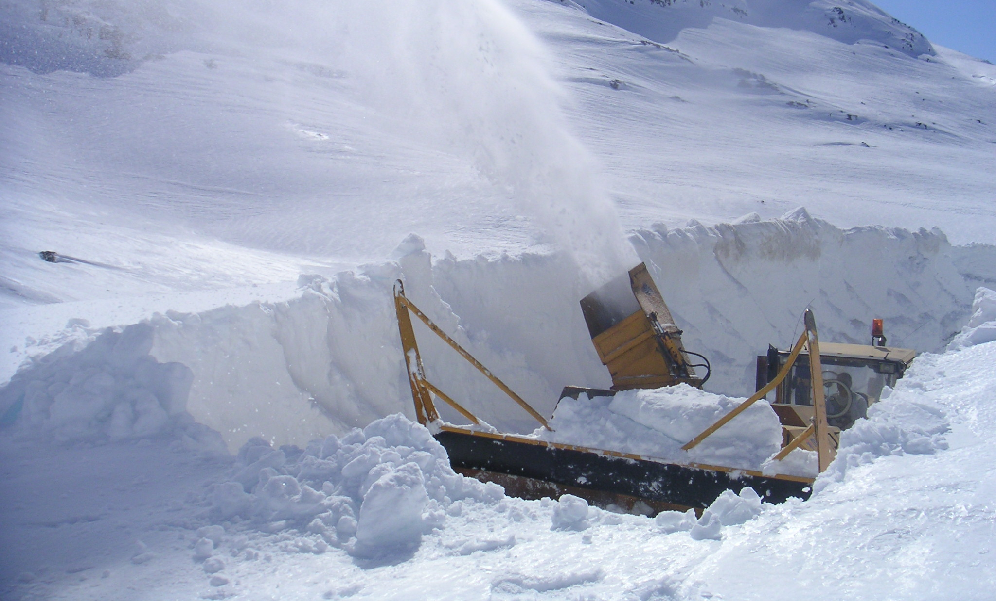
Photo: Oddvar Øvregård, Statens vegvesen
Theory
Notes:
Before we move into the research results, let’s walk through some theoretical foundations

Slide 9
DIKW - Data, Information, Knowledge and Wisdom
The DIKW Hierarchy. Adapted from (Rowley, 2007).
Notes:
The hierarchy of Data, Information, Knowledge and Wisdom has been described as a pyramid, where data is at the lower level, followed by information and knowledge, and wisdom at the pinnacle. Each level of the hierarchy, starting from the top, relies on the level below: wisdom is gained from knowledge; knowledge is gained from information; information is gained from data.
Data are simple symbols. For example, the numbers «90» or «2».
Information is data put into context, where it has a meaning. For example, the speed limit 90 km/h or outdoors temperature 2 degrees Celcius.
Knowledge is gained by combining information. For example, a vehicle can know that it is allowed to drive at 90 km/h according to the speed limit, but also that it should reduce the speed due to possible challenging conditions because the outdoors temperature is 2 degrees.
The final level, wisdom, has been described as a purely human state. With wisdom, we are able to plan for the future and apply knowledge to new situations.

Slide 10
Information models and ontologies
Information model
“… a formal description of types of ideas, facts and processes which together form a model of a portion of interest of the real world and which provides an explicit set of interpretation rules.” (Schenck and Wilson, 1994).
“… a representation of concepts, relationships, constraints, rules, and operations to specify data semantics for a chosen domain of discourse” (Zhao et al., 2011)
≈ Ontology
“… a set of precise descriptive statements about some part of the world (usually referred to as the domain of interest or the subject matter of the ontology)” (Hitzler et al., 2012)
“… a common vocabulary for researchers who need to share information in a domain. It includes machine-interpretable definitions of basic concepts in the domain and relations among them”. (Noy and McGuinness, 2001)
Vocabulary
“terminological dictionary that contains designations and definitions from one or more domains or subjects”.
Rules to understand data in a context
Implements the concepts in a modelling language
Defines the concepts
Notes:
Information models are the interpretation rules needed to extract information from data. My thesis was based on an understanding of the term information models from Schenk and Wilson in 1994: “… a formal description of types of ideas, facts and processes which together form a model of a portion of interest of the real world and which provides an explicit set of interpretation rules.”
A similar definition was described by Zhao et al in 2011: “… a representation of concepts, relationships, constraints, rules, and operations to specify data semantics for a chosen domain of discourse”.

Slide 11
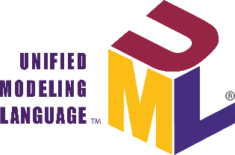

Information modelling
From the real world to conceptual models.
Jetlund, K. (2021). Harmonizing and linking conceptual models of geospatial information. Faculty of Engineering, Department of Manufacturing and Civil Engineering, Norwegian University of Science and Technology. PhD: 207.
Notes:
The definitions in the previous slide mentioned “a portion of interest” and “a domain of discourse”. These terms are an important fundament for the process of information modelling. Obviously, one single model cannot describe every concept from the real world in every context, we need to define some portion that we are interested in, such as a road network, buildings or utilities.
This figure, which is adapted from ISO 19101, describes the process of information modelling, where the first step is to select a portion of interest from the fuzzy cloud we know as the real world and perceive it in a context. The portion of interest is often referred to as a universe of discourse.
The universe of discourse will be defined in a conceptual model, but in order to create a formal description, we need some kind of formalism. For this, we need a conceptual schema language, which can describe the model in a conceptual schema. Two such conceptual schema languages are the Unified Modelling Language, UML, and the Web Ontology Language, OWL.

Slide 12
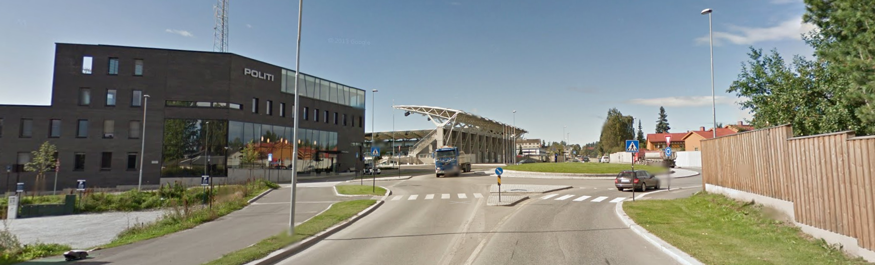
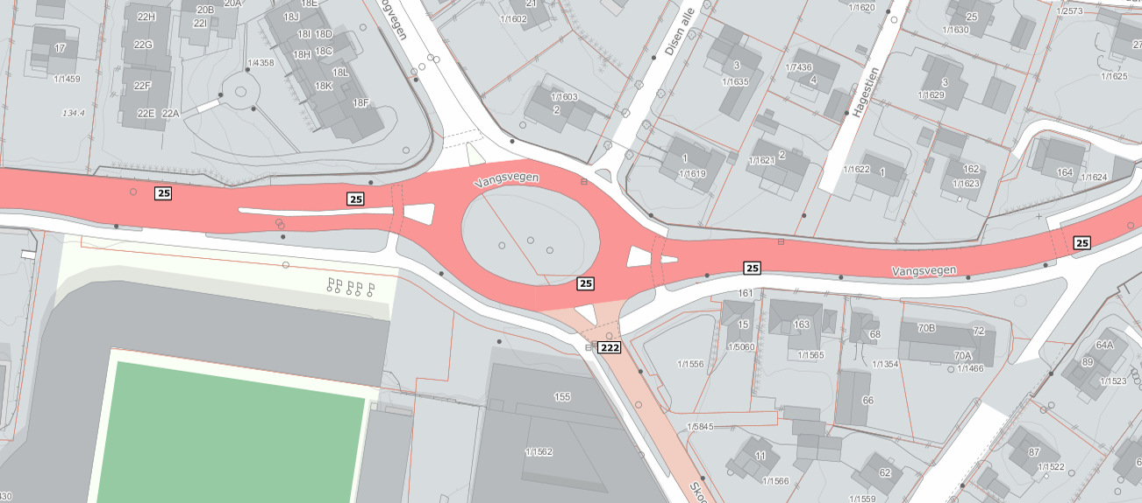
From the real world to data set
“…an ecosystem where a multitude of digital twins are brought together in an integrated digital environment can cover larger portions of the real world, give a broader view and serve multiple purposes.”
(Jetlund, 2021)
Notes:
When working with data and information, this is where we start. There is a real world out there, and we want to represent it digitally in a way that is fit for our purpose, for example in a map.
In order to do so, we need to define what part of the real world we are interessted in (UoD), and in what context we are studying this UoD. In that context, we define a conceptual model that defines the digital representation, and create data according to that model. For example, we define the class Road, and represent the roads in the picture as objects with polygon geometry. And the same with the poles, fences, buildings and so on.
But for some other context, we may need a different conceptual model of the same UoD, or of a similar but not identical UoD. Therefore, we end up with several conceptual models and several data sets, fit for different contexts, and representing different UoD. In other words: several digital twins.

Slide 13

Model-Driven Architecture (MDA)
Platform Independent Model
Platform Specific Model
Platform Model
Jetlund, K. (2021). Harmonizing and linking conceptual models of geospatial information. Faculty of Engineering, Department of Manufacturing and Civil Engineering, Norwegian University of Science and Technology. PhD: 207.
Notes:
A much used apporach for information modelling is…
PIM, PSM, PM
Level of abstraction:
Most abstact – network, time, geometry.
Realized and reused in less abstract domain models
Model transformation to PSM, add more semantics needed for implementation in specific technologies. But we are still in an modelling language, for example UML
Transformation to implementation schemas – GML (XML), JSON or SQL.
With this approach, conceptual models can be developed indepent of implementation technologies.

Slide 14

Open world, closed world
Closed World Assumption (CWA)
The information model is complete in the given context
Additional or deviating information is invalid
Open World Assumption (OWA)
The information model presents only what is currently known in the given context
Nothing is true unless explicitly stated
Anyone can say anything about any topic (AAA)
Additional information extends the model
EXPRESS
Notes:
We also need to consider two distinct approaches for analyzing and representing the real world: Eiter as an open or closed world.

Slide 15
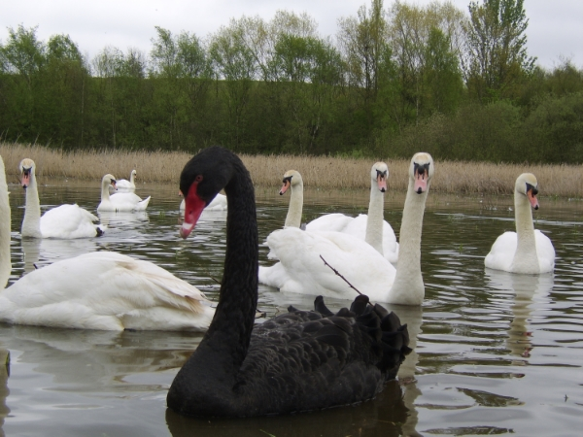
White swan, black swan
Closed World Assumption (CWA)
“ This object is a swan”
“ All swans are white”
Open World Assumption (OWA)
“I classify this thing a bird of the species Swan, with a white color.”
“I classify this other thing a bird of the species Swan, with a black color.”
“Swans may have other colors that I am not aware of.”
EXPRESS
From http://www.millennialplanners.com

Slide 16
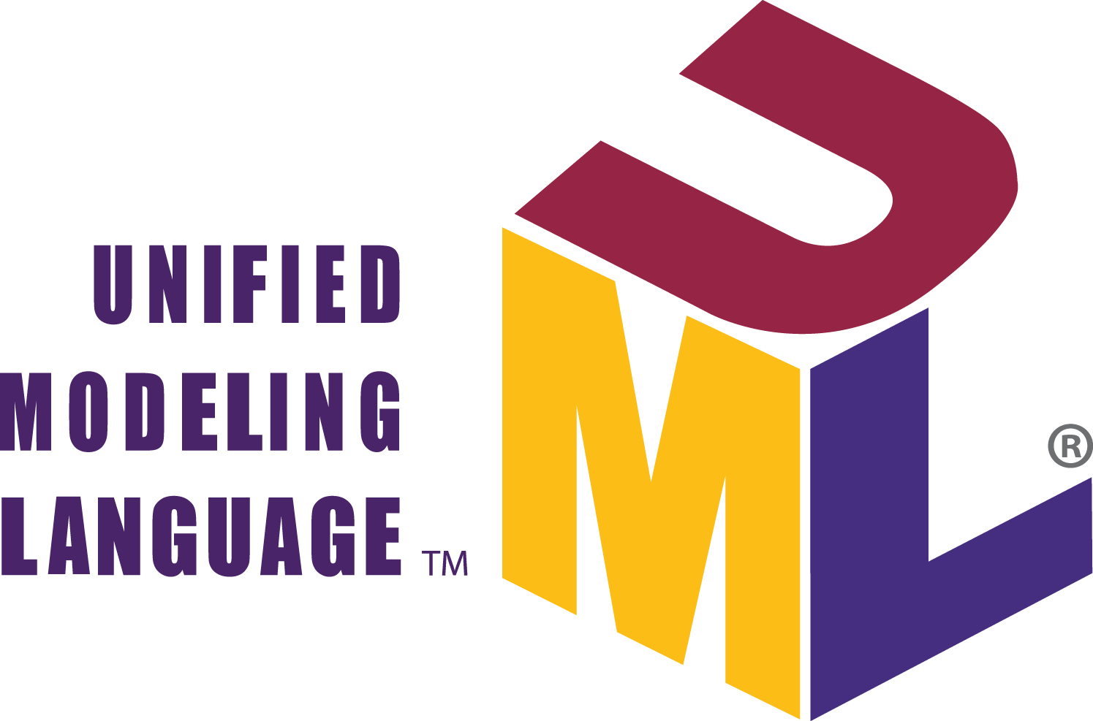
Interoperability
ISO/IEC 2382:2015 :“capability to communicate, execute programs, or transfer data among various functional units in a manner that requires the user to have little or no knowledge of the unique characteristics of those units”.
Same meaning:
What is a guardrail?
Same syntax: UML, EXPRESS, XML, OWL
Notes:
ISO/IEC 2382:2015 (ISO/IEC JTC 1,
2015) has defined interoperability as “capability to communicate, execute programs, or transfer
data among various functional units in a manner that requires the user to have little or no
knowledge of the unique characteristics of those units”.
The levels of conceptual interoperability has been discussed by many researchers, ranging from no interoperability to full conceptual interoperability. The four core levels are… Additional levels for dynamic and conceptual

Slide 17
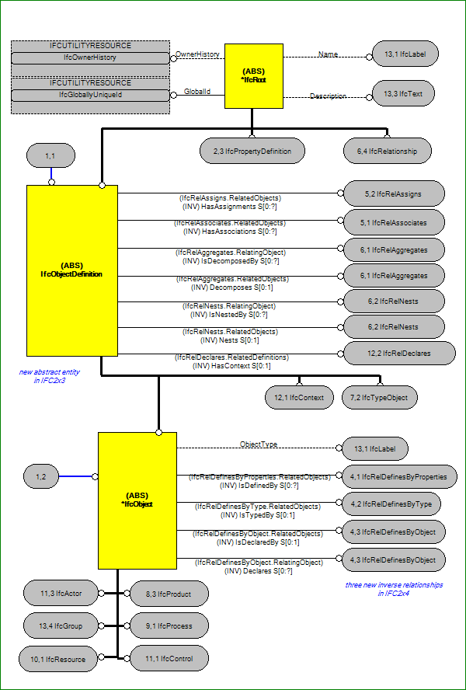
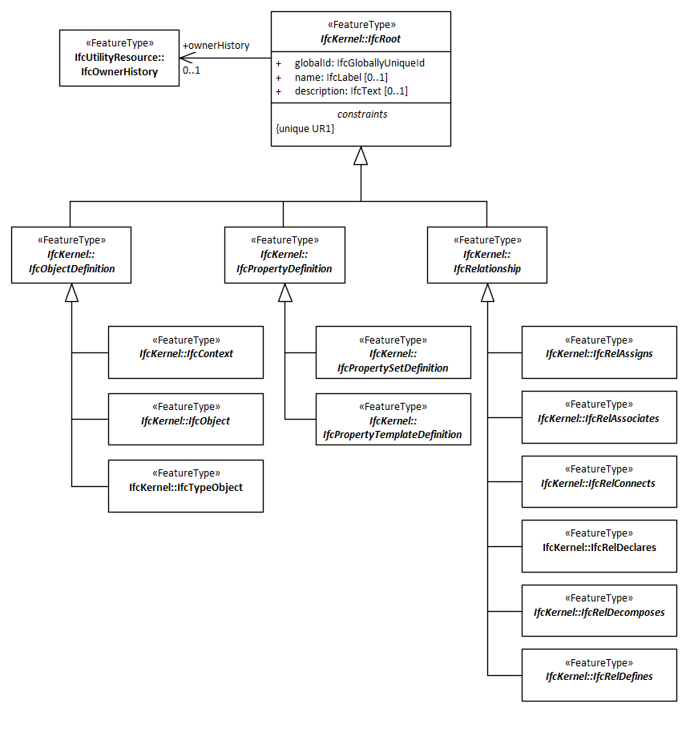
Syntactic interoperability
EXPRESS

Slide 18
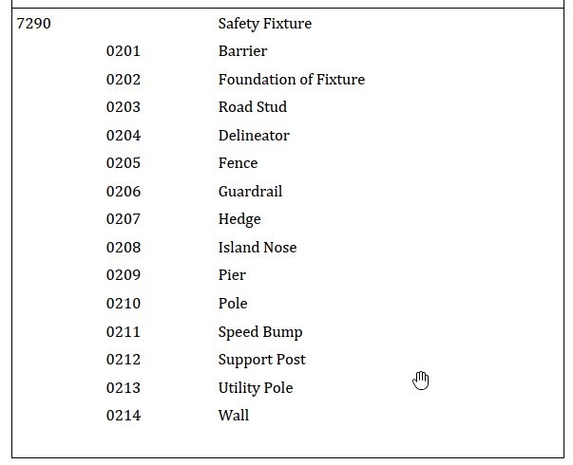
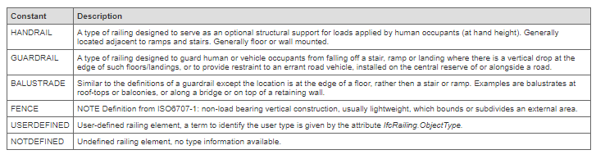
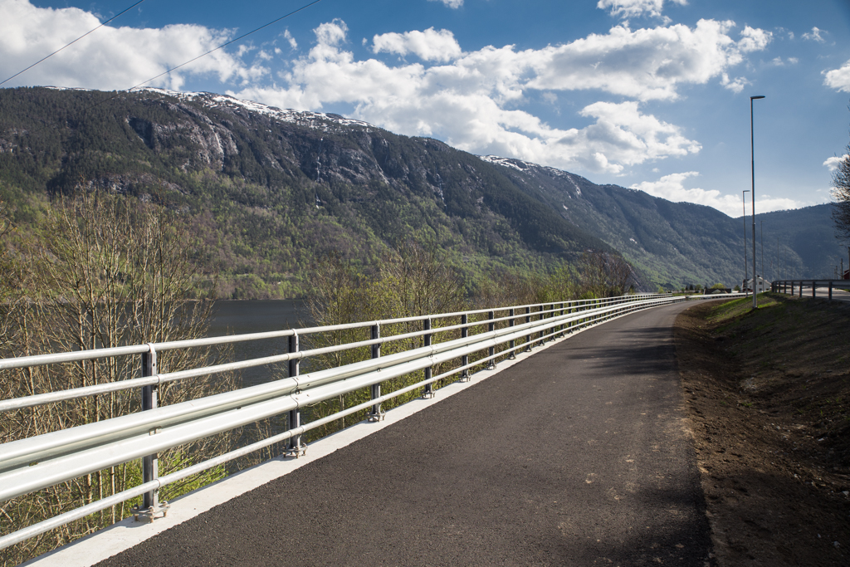
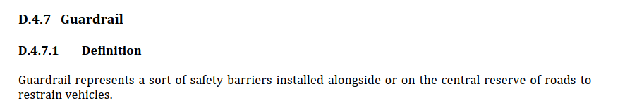
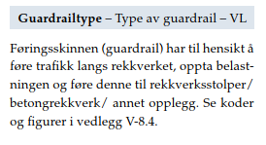
Semantic interoperability
GDF – Safety fixture
IFC - IfcRailingType
What is a guardrail?
V.440 – Railing with guardrail
Photo: Silje Drevdal / Statens vegvesen

Slide 19
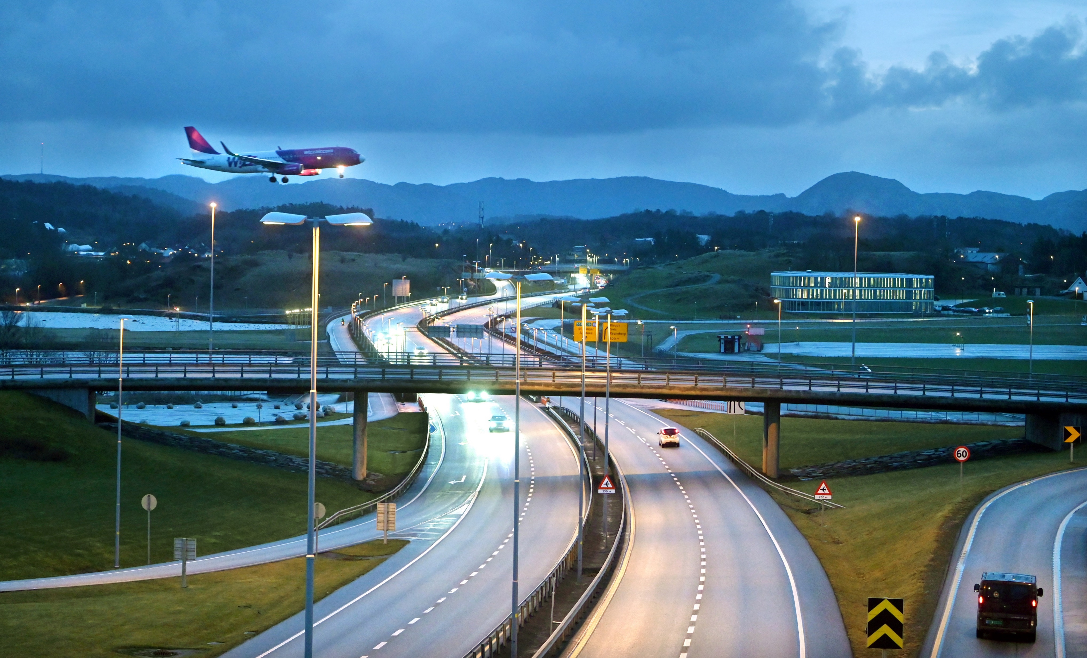
Research
Photo: Øyvind Ellingsen, Statens vegvesen
Notes:
So, with the theoretical background in place, let’s look at the results from the research.

Slide 20
Reuse of information across domain borders
The challenge:
Reuse requires a common understanding of how the real world is described in information models
Modelling language
Terminology
Geometry and location referencing
Exchange technologies
Photo: Knut Opeide, Statens vegvesen
Notes:
While the roles of GIS, ITS and BIM are distinct, and the application domains see the real world from different perspectives, the picture shows us that many of the real-world features and concepts they handle are the same. Therefore, reuse of information across application domain borders should be possible.
Before this road was built, there was mostly a natural environment, represented in GIS data sets. The new road was planned, developed and constructed with support from BIM processes. During the construction, the road cut into and changed the existing natural and built environment and became an integrated part of a new physical environment. Therefore, the GIS data sets need to be updated with the new built environment, as well as the changed natural environment. Also, ITS applications for route planning and navigation need an updated representation of the road environment, and of restrictions for navigation, such as speed limits and forbidden manoeuvres.
Let’s use the railings in this picture as an example: The digital representation of a guardrail along a new road will begin its life in the planning stage for the road, where the railing is created in a BIM application, as a feature that shall be constructed. The feature representation of the railing should later be reused in GIS datasets, for presentation on maps, and, for example, for calculating noise pollution. Furthermore, the same railing is needed in High Definition maps for ITS as an obstacle that vehicles need to be aware of. The different domains need specific information about the feature, but they are all referring to the same real-world phenomenon.
The challenge we face in the exchange and reuse of information is that the different application domains have developed information models with their specific interpretation of the real world. In order to understand information across domain borders, we need a common understanding of how the real world is described in information models. This concerns the modelling languages that are used, the terminology, how geometry and location references are described, and the exchange formats that are used.

Slide 21
How can we achieve a common understanding?
Research question:
“How can approaches and technologies for information modelling be applied for harmonization and linking of conceptual models of geospatial information from the three application domains of GIS, ITS and BIM?”
Jetlund, K. (2021). Harmonizing and linking conceptual models of geospatial information. Faculty of Engineering, Department of Manufacturing and Civil Engineering, Norwegian University of Science and Technology. PhD: 207.
Notes:
So, how can we achieve this common understanding?
This was the main research question for the thesis, formulated as: «How can approaches and technologies for information modelling be applied for harmonization and linking of conceptual models of geospatial information from the three application domains of GIS, ITS and BIM?”
As we have seen from the previous slides, the three application domains have different views on the real world. And, most likely, they will need to be different, as they use the digital representations in different ways and for different purposes. We need to acknowledge that a full harmonization of information models may not be appropriate. Therefore, the thesis studies harmonization, and linking, of heterogeneous models, as illustrated in the figure. We strive for a harmonization but acknowledge the need for linking in addition.

Slide 22
Jetlund, K. (2021). Harmonizing and linking conceptual models of geospatial information. Faculty of Engineering, Department of Manufacturing and Civil Engineering, Norwegian University of Science and Technology. PhD: 207.
Notes:
The main research question was supported by five sub research questions, which in sum were intended to cover information modelling in the three application domains, the roles they have in the digital geospatial environment, and the relations between them.
The questions were addressed through five published articles and a conference proceeding, as well as through contributions to other relevant work in international standardization.
As shown in the figure, there were relations between the sub research questions: The first question established the fundament for addressing the four others, and question 4 depended on input from question 2, 3 and 5.

Slide 23
Research articles
Information Exchange between GIS and Geospatial ITS Databases Based on a Generic Model: http://www.mdpi.com/2220-9964/8/3/141
Improvements in automated derivation of OWL ontologies from geospatial UML models: https://www.int-arch-photogramm-remote-sens-spatial-inf-sci.net/XLII-4/283/2018/
Adapted Rules for UML Modelling of Geospatial Information for Model-Driven Implementation as OWL Ontologies: https://www.mdpi.com/2220-9964/8/9/365
IFC Schemas in ISO/TC 211 compliant UML for improved interoperability between BIM and GIS: https://www.mdpi.com/2220-9964/9/4/278
A structure of UML profiles for modelling of geospatial information in GIS, ITS and BIM: https://www.isprs-ann-photogramm-remote-sens-spatial-inf-sci.net/VI-4-W1-2020/101/2020/

Slide 24
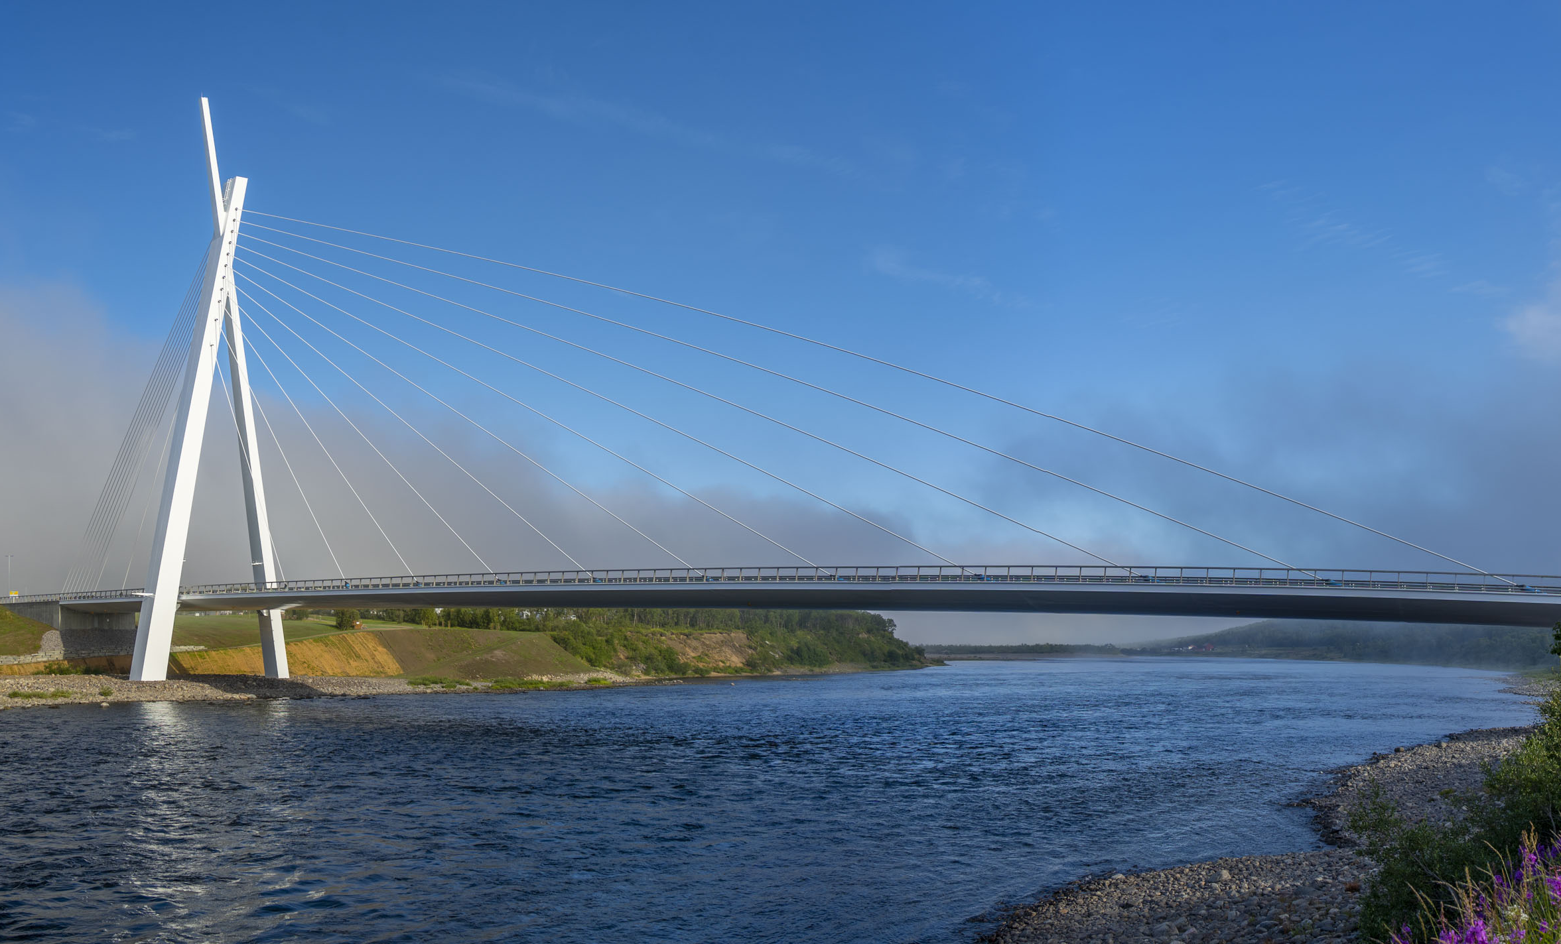
Results
Photo: Frank Martin Ingilæ, Statens vegvesen
Notes:
So, with the theoretical background in place, let’s look at the results from the research.

Slide 25
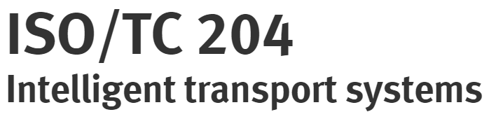

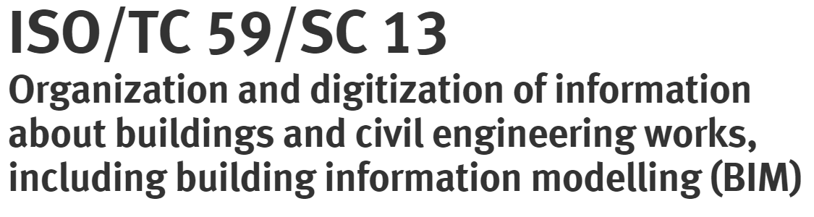


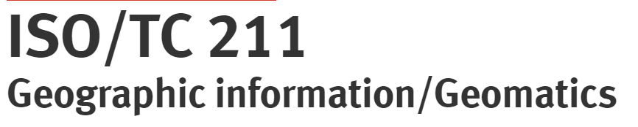
SRQ1: State of the art
“What approaches and technologies have been used for modelling geospatial information in GIS, ITS and BIM?”
All three application domains:
Conceptual schemas in UML
Some degree of MDA
UML and MDA for GIS is the most complete approach
But with defeciencies
Notes:
The state-of-the-art analysis showed that standards and specifications from all three application domains describe models of geospatial information, with various approaches and technologies.
A number of specifications exist in the ITS domain, but the ISO/TC 204 standard GDF has been identified as the primary official model for geospatial information. While the Navigation Data Standard is an essential industry standard. Other essential ITS standards are TPEG2 and DATEX II for dynamic information.
In the BIM domain, the core concepts for geospatial information are defined in the IFC specification, developed by buildingSMART and standardized by ISO/TC 59.
In the GIS domain, ISO/TC 211 and OGC have standardized the basic concepts for the use of MDA and UML in a range of standards, and organizations all over the world have developed domain models of geospatial information based on those standards.
A common denominator for all application domains was the use of UML as the conceptual schema language, and modelling approaches with some degree of MDA.
The information modelling approach in GIS as standardized by ISO/TC 211 was identified as the most structured and complete approach for modelling geospatial information.
The defined UML profiles, the MDA approach with specified levels of abstraction, modelling and conversion rules, and the modular structure, are advantages compared to approaches in the two other application domains. However, deficiencies were found in the GIS approach as well, by this research as well as others.
Therefore, the further research focused on the development of an improvement of the GIS approach, and the development of domain models according to the improved approach.

Slide 26


ISO/TC211
Geographic information/Geomatics
Standardization in the field of digital
geographic information.

Slide 27
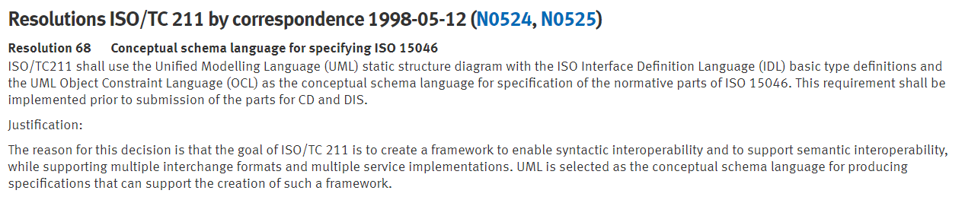
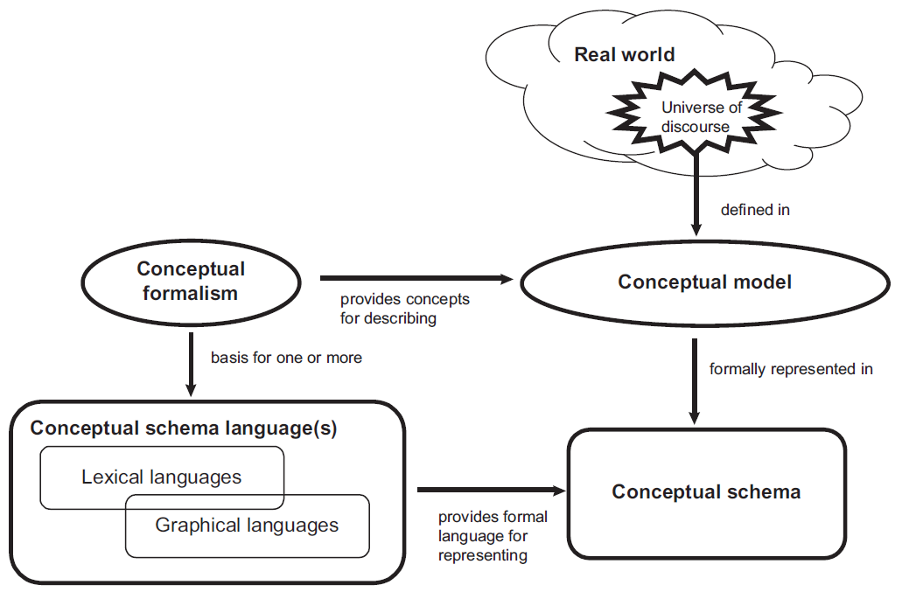
The ISO/TC 211 Information modelling approach
From ISO 19103:2015

Slide 28

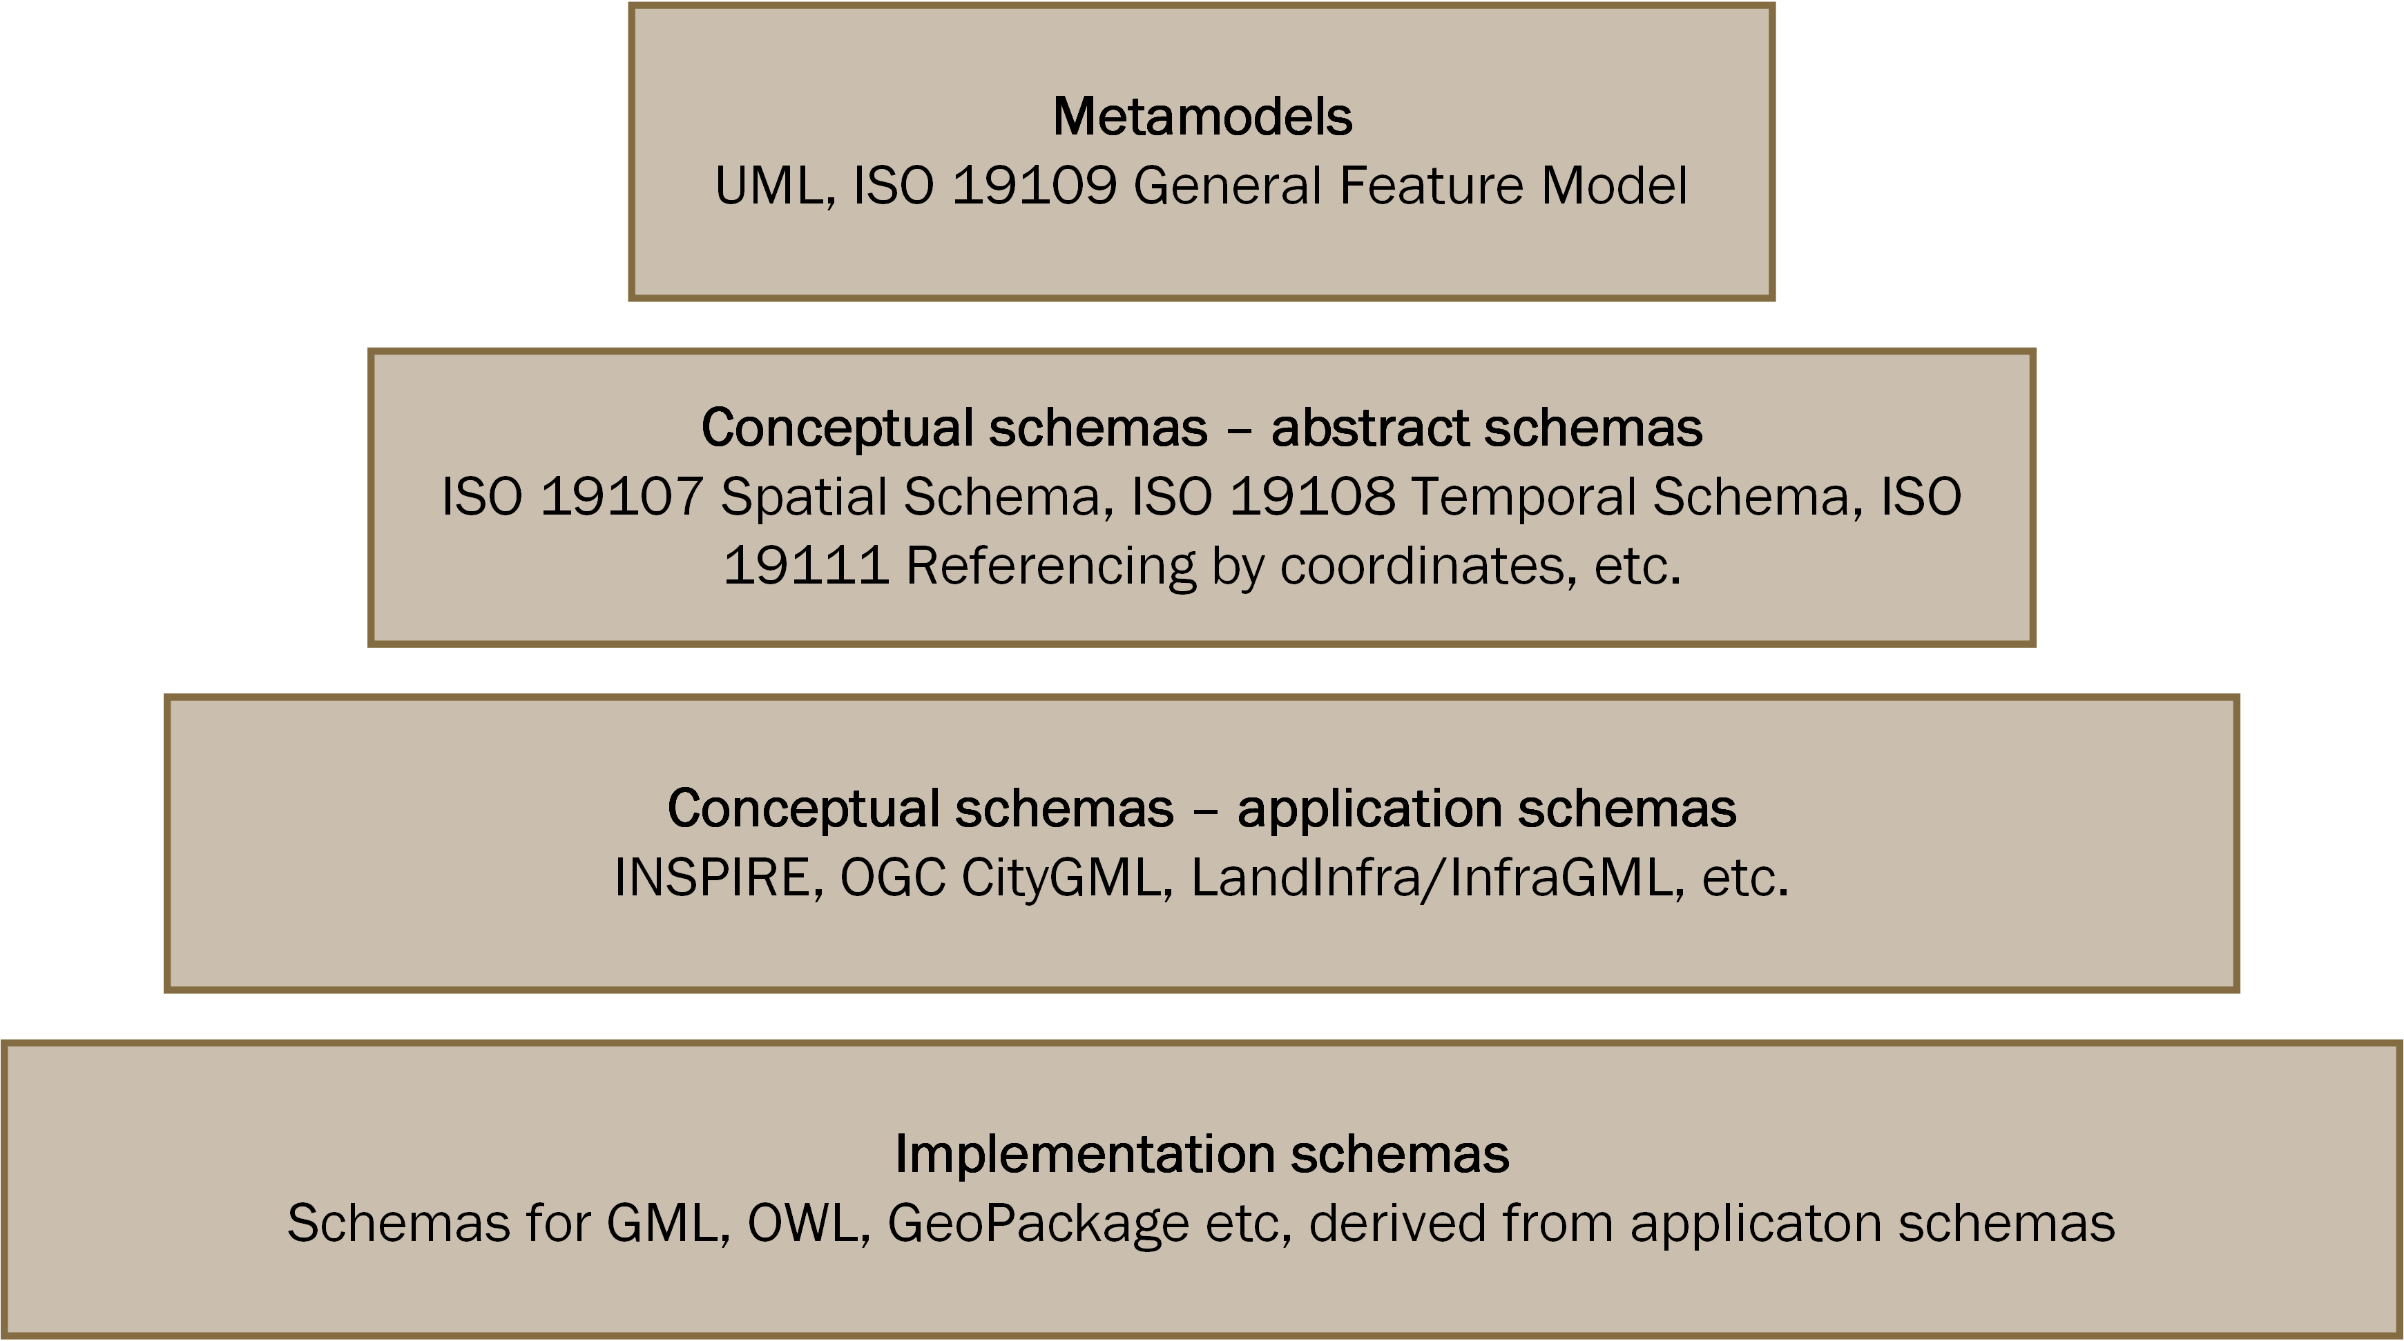
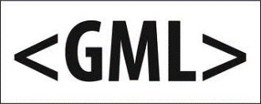
ISO/TC 211 Model Driven Architecture
ISO/TC 211
From: Jetlund, K., Onstein, E., Huang, L., Information Exchange between GIS and Geospatial ITS Databases Based on a Generic Model. Isprs International Journal of Geo-Information 2019, 8(3), p. 141,DOI: ARTN 141 10.3390/ijgi8030141.

Slide 29
The ISO/TC 211 MDA Framework
From: Jetlund, K., et al. (2019). "Adapted Rules for UML Modelling of Geospatial Information for Model-Driven Implementation as OWL Ontologies." ISPRS International Journal of Geo-Information 8(9): 365.

Slide 30
UML Modelling rules: ISO 19103 UML Profile
ISO 19103:2015 Geographic information — Conceptual schema language (Figure D.29)

Slide 31


UML Modelling rules: ISO 19109 The General Feature Model (GFM)
ISO 19109:2015 Geographic information — Rules for application schemas (Figure 5)

Slide 32
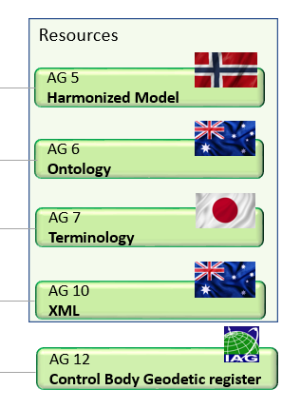
ISO/TC 211 AG 5 The Harmonized Model Maintenance Group (HMMG)
Core responsibility
Ensure that UML models and derived resources for implementation are maintained and made accessible
Establish, maintain and make available the Harmonized UML Model
Coordinate the use of UML
Coordinate the work on resources for implementation
Close cooperation with the XMG, GOM and TMG

Slide 33
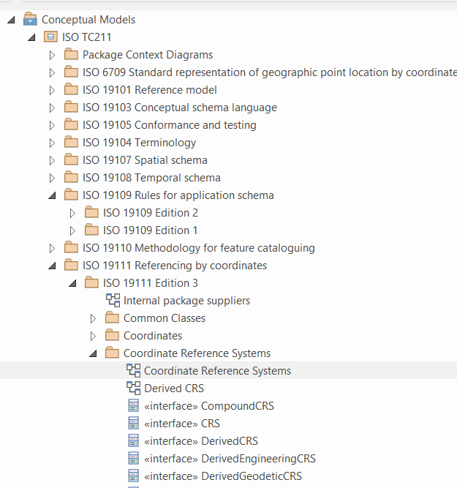

The Harmonized UML Model
All UML models in one repository
Sparx Enterprise Architect
iso.sparxcloud.com
Reuse of concepts
Internally in ISO/TC 211 standards
Externally: OGC, INSPIRE, Domain models, National models
Foundation for model-driven implementation

Slide 34
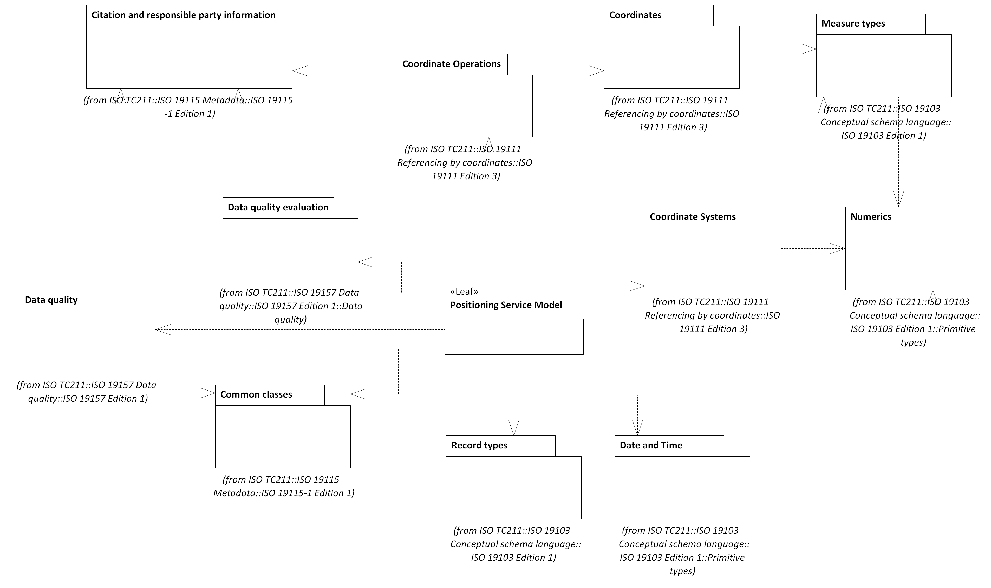
Example dependencies (ISO 19116)

Slide 35
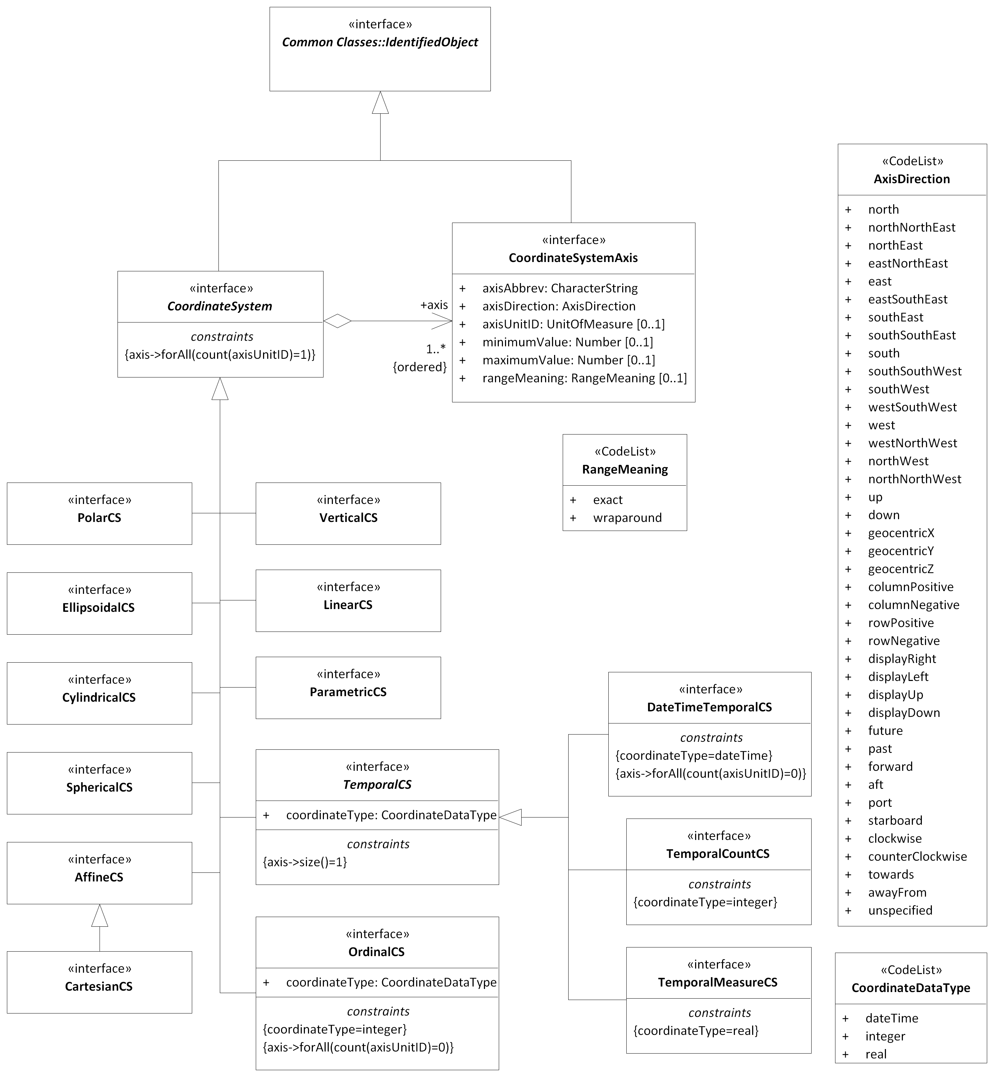
The UML models are the standards!
The formal standard document presents the model as text and figures…
…and add normative statments, conformance classes and conformance tests…
…but the UML model is the original!

Slide 36
Standardized Model-Driven Implementation
ISO 19136 Geography Markup Language
XML for geospatial information
Rules for UML Modelling (PSMs)
Rules for conversion from UML to GML
ISO 19139 XML schema implementation
General rules for conversion from UML to XML
ISO 19150-2 Ontologies
Rules for conversion from UML to OWL

Slide 37
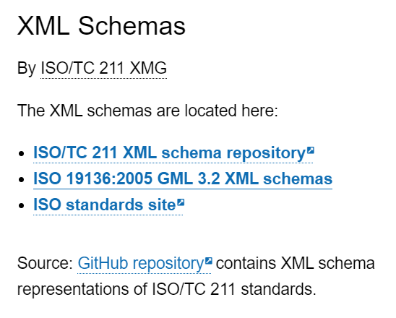
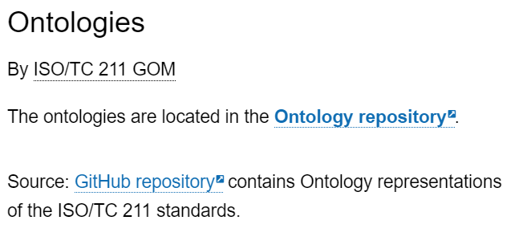
Derived Resources for Implementation
Derived from The Harmonized UML Model:
XML Schemas https://schemas.isotc211.org
OWL Ontologies https://def.isotc211.org

Slide 38
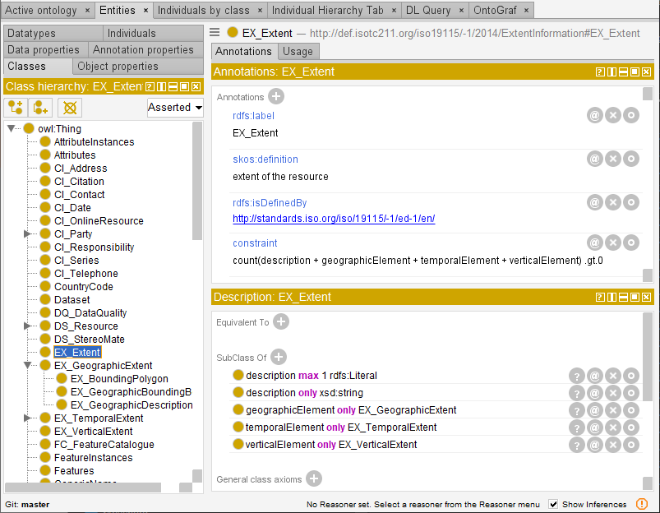
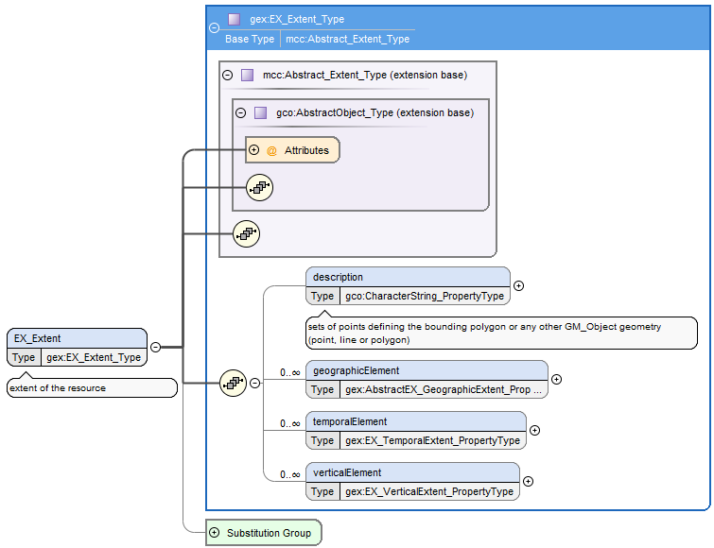
The schemas are the resources for implementation!
The standard document presents the model as text and figures…
…and add normative statments, conformance classes and conformance tests…
…the UML model is the original…
…but the schema is the resource needed for implementation!

Slide 39






Application schemas and implementation schemas
Global
Regional
National

Slide 40
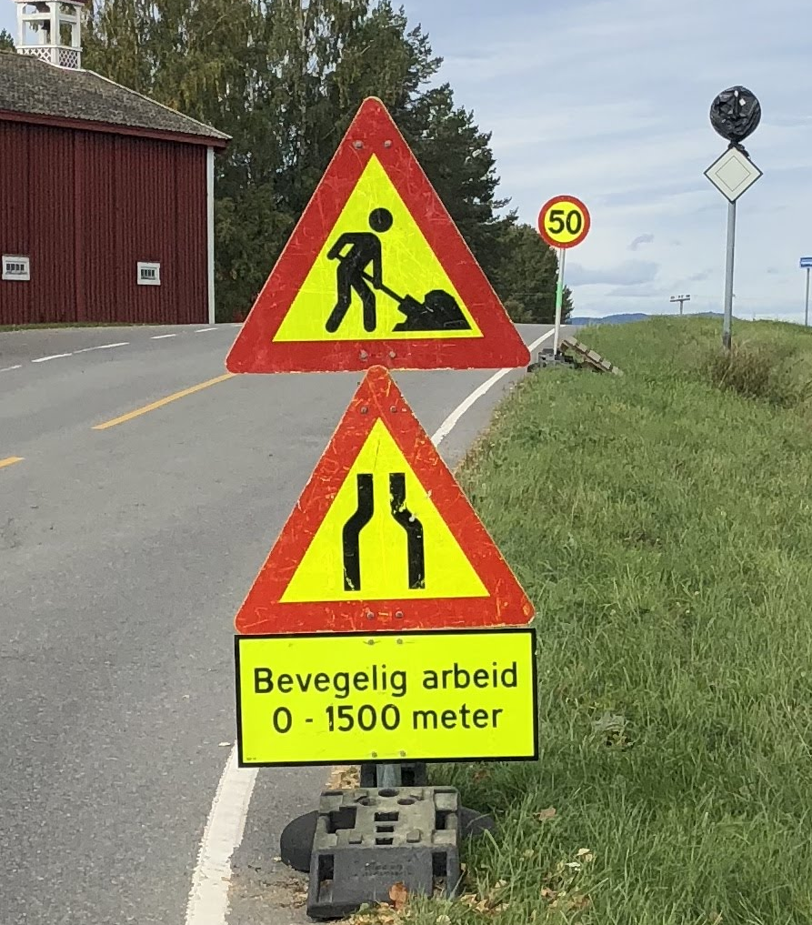
Conceptual model of a modular specification
For automated documentation
Extending ISO 19105 – Conformance and Testing
Work in progress!

Slide 41
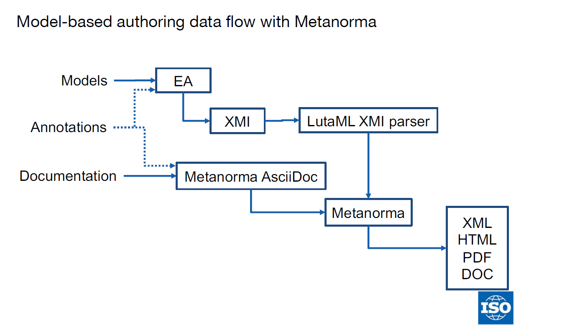
Automated documentation
Work in progress!
https://www.ribose.com/about

Slide 42
Results
Photo: Frank Martin Ingilæ, Statens vegvesen
Notes:
So, with the theoretical background in place, let’s look at the results from the research.

Slide 43
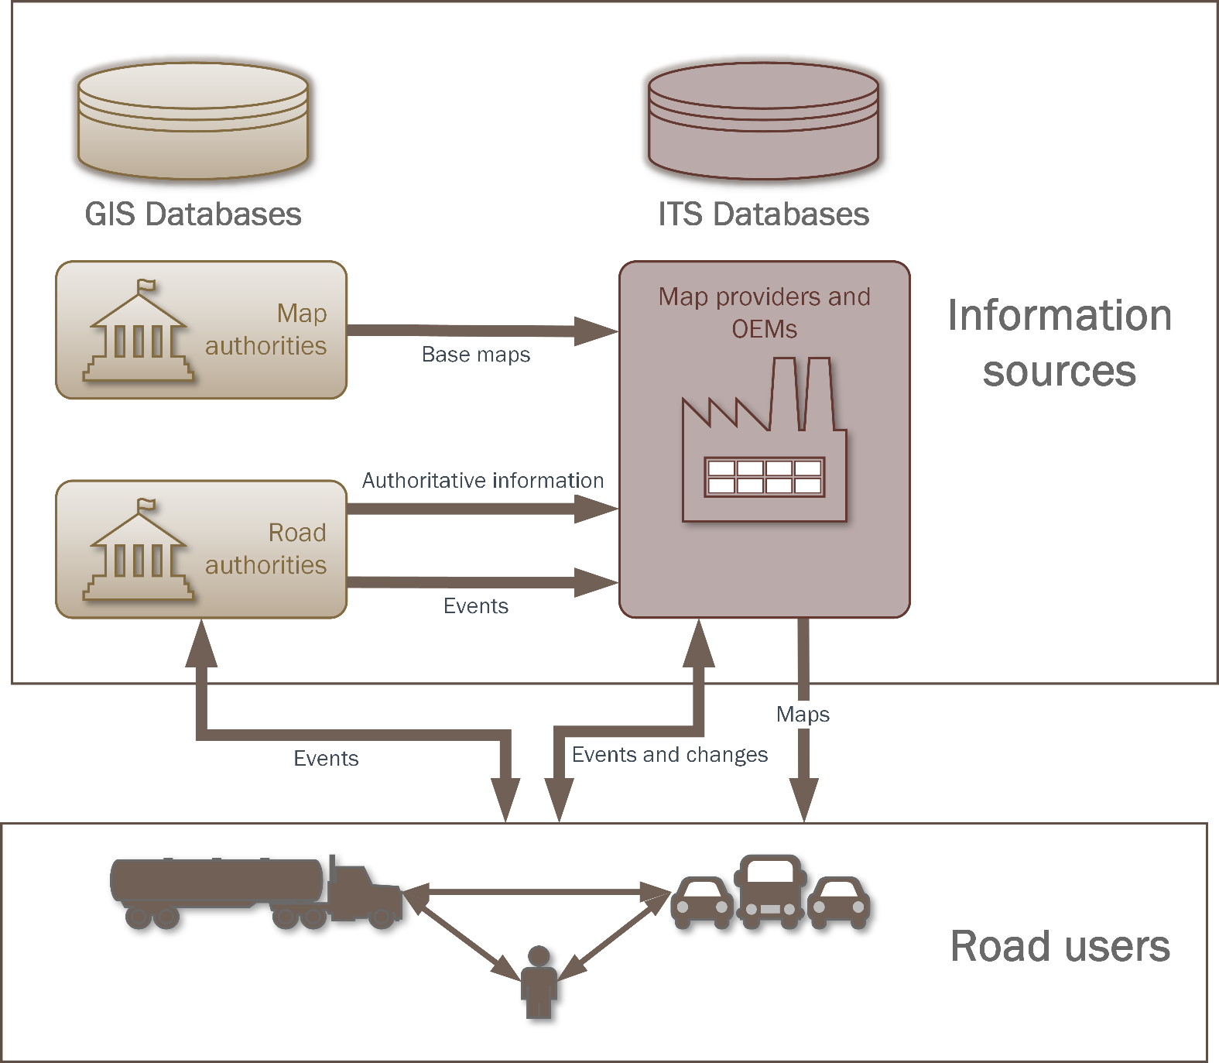
SRQ2: Information exchange from GIS to ITS
“How can models for exchange of geospatial information from road and mapping authorities to geospatial databases for ITS be improved?”
Prototype experiment
Req 1: ISO/TC 211 MDA
Req 2: GIS exchange format
Req 3: Feature catalogue
Req 4: Feature catalogue exchange model
Req 5: Network model
Req 6: Generic feature exchange model
Jetlund, K., et al. (2019). "Information Exchange between GIS and Geospatial ITS Databases Based on a Generic Model." ISPRS International Journal of Geo-Information 8(3): 141.
Notes:
The second sub research question concerned the information exchange from GIS to ITS, as illustrated in this figure from Article 1.
Modern vehicles contain a range of sensors and create local geospatial knowledge from them. However, this knowledge is not sufficient for route planning or for local navigation under challenging conditions such as fog or snow-covered roads. It must be combined with geospatial information from pre-processed databases. Road authorities are the authoritative source for the information needed for legal and safe navigation in the road network, and maintain the information in applications and databases from the GIS domain. Sub research question 2 studied information models for providing this information to map providers in the ITS domain, as illustrated by the horizontal arrows in the figure.
We set up six requirements for such information models, as listed in this table, and evaluated ten existing standards and specifications. The requirements were specified for studying two main topics: Usability in GIS, and flexibility for changes in feature catalogues.
The analysis showed that none of the studied solutions met all requirement, but four of the ten were promising candidates as a basis for an improved solution. From this, we set up a prototype experiment with an improved solution.

Slide 44
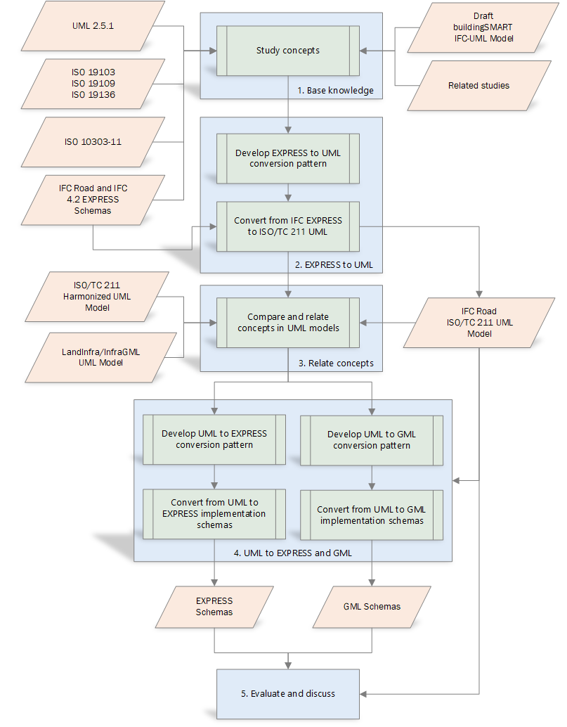
SRQ3: Integration of models for GIS and BIM
Syntactic
Semantic
“How can information models and semantics for implementation technologies for BIM be integrated and linked with GIS standards?”
Implementation
Jetlund, K., et al. (2020). "IFC Schemas in ISO/TC 211 compliant UML for improved interoperability between BIM and GIS." ISPRS International Journal of Geo-Information 9(4).
Notes:
The third research question concerned the integration between GIS and BIM, by asking how information models and implementation technologies for BIM could be integrated and linked with GIS standards.
A prototype experiment was set up for conversion from IFC EXPRESS schemas into ISO/TC 211 compliant UML models.
The syntactic interoperability was addressed by a conversion pattern from EXPRESS, as used in IFC, to UML, as used in ISO/TC 211 standards.
Furthermore, semantic interoperability was addressed by linking and mapping core concepts from IFC to concepts defined in ISO/TC 211 standards.
Finally, the prototype UML model was tested for implementation in EXPRESS, as a kind of re-engineering, and in GML through ISO/TC 211 rules for conversion.

Slide 45
Syntactic interoperability
EXPRESS

Slide 46
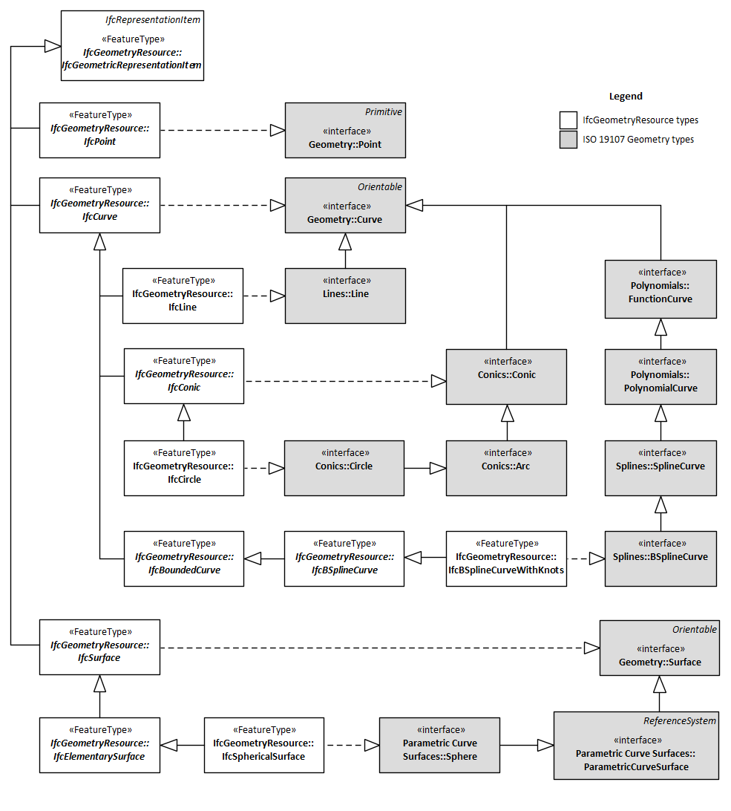
Semantic interoperability
Geometry
ISO 19107 Spatial schema
IfcGeometryResource
IfcGeometricModelResource IfcGeometryConstraintResource

Slide 47
Validation:
The BIM/GIS prototype
Syntactic interoperability
Most EXPRESS concepts maintained
Semantic interoperability
Not all concepts could be linked
Common concept preferred
Implementation
Extra semantics for EXPRESS
Mapping of geometry concepts vital for GML
Notes:
Validation of the prototype showed that the conversion pattern maintained most of the EXPRESS concepts from IFC, while a few concepts needed a more complex and controlled conversion.
Furthermore, the semantic interoperability was improved by linking data types from IFC to equivalent types from ISO/TC 211 standards. However, not all data types could be linked. Better semantic interoperability could be reached if models reused basic datatypes from more general models. Especially, better semantic interoperability for geometry and location referencing datatypes would be possible if original datatypes were defined in one of the models and reused in both.
For the implementation, the results showed that EXPRESS implementation was possible through the reverse conversion pattern. The implementation in GML, based on the standardized rules for conversion, was also possible, due to the established links between core concepts. However, the incomplete harmonization, and linking, of data types for geometries and location referencing proved to be a challenge for implementation in GML and could have been improved with the use of common concepts.

Slide 48
SRQ5: Ontologies for linking and mapping
“How can UML models of geospatial information be implemented as OWL Ontologies, for linking and mapping by applying Semantic Web technologies?”
Notes:
I will now move to sub research question five, and come back to number four later.
Sub research question five concerned the relationship between UML models and OWL ontologies, focusing on the use of OWL Ontologies for linking and mapping of heterogeneous models of geospatial information. As we remember from the illustration of the main research question, we acknowledged that the models could not be completely harmonized, and that additional linking and mapping would be necessary. Semantic web technologies such as OWL and SPARQL have been considered a valuable approach for this purpose.
In order to enable UML models for use in the Semantic Web, the UML models must be converted to OWL ontologies, and this conversion was the topic for the sub research question.

Slide 49
Fundamental differences
Closed World Assumption (CWA)
Open World Assumption (OWA)
Structure of information
- The class «Swan» with specific properties
Meaning of concepts
- A «Swan» is a subclass of the class «Bird», if specific properites with specific values are given
→ The derived ontologies tend to be a bit “UML-ish”
Notes:
The studies found that conversions from UML to OWL are possible, and have been described in ISO/TC 211 standards, OGC Testbeds, and in related research. However, some challenges were identified and were mainly related to fundamental differences between how UML and OWL describe the real world.
First, UML focuses on the structure of information, while OWL focuses on the meaning of concepts. In UML, we define, for example, that a feature is a Railing, and has specific properties, while another feature is a Fence and has its specific properties as well. While in OWL, we define that a thing that has some defined properties is a Railing, but it can also be a Fence at the same time. Which is more like we see it in the real world: The same feature may be a railing and a fence. Classification depends on the context.
Besides, properties in OWL so-called first-class individuals who exist on their own, while UML attributes and associations are uniquely owned by the individual class.
Furthermore, UML models are defined in a closed world assumption, where we assume that the model is complete in the given context. Information that does not fit the model will be invalid. Contrary, OWL is based on an open-world assumption, where anyone can say anything about any topic. The model represents only what is currently known in the given context and may be extended with additional information.
---
Due to these differences, UML models are more restricted, and representations of UML restrictions is a challenge for the conversion from UML to OWL.

Slide 50
Level of information flow
Conversions of restrictions from the CWA to the OWA must be configured according to the selected level of information flow:
Ontologies for use only in the Semantic Web
Unidirectional information exchange to the Semantic Web
Bidirectional information exchange
Notes:
The most essential observation from the sub research question was that the need for maintaining restrictions from UML in OWL will depend on the intended level of information flow for the resulting ontologies. We defined three levels of information flow:
Ontologies for use only in the Semantic Web, in which case restrictions and the original structure from the UML models can be disbanded.
Unidirectional information exchange from UML based models to the Semantic Web. As for the first level of information flow, few restrictions from the UML model are needed in the ontologies, as they will primarily be used for describing the information.
Bidirectional information exchange. For this purpose, the OWL ontologies and the original UML model should be as identical as possible. The information must be valid according to the UML models to make sure it can be imported into repositories defined by the UML models. Therefore, conversions need to maintain restrictions and the original structure as far as possible.
Model-driven conversions from UML to OWL need to consider the different levels of information flow and apply conversions appropriate for the selected level. Therefore, conversion rules, and software implementing the rules, need to be configurable.

Slide 51
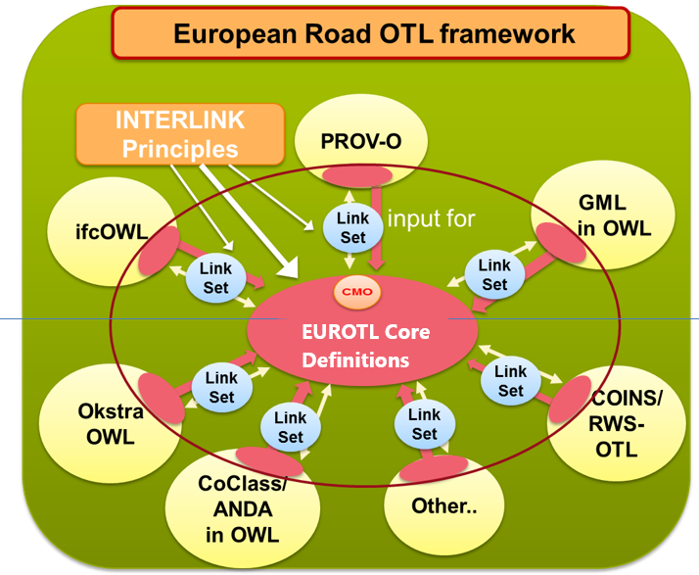
Linking and mapping information models
http://wpd1.s3.eu-central-1.amazonaws.com/index.html
Jetlund, K. (2021). Harmonizing and linking conceptual models of geospatial information. Faculty of Engineering, Department of Manufacturing and Civil Engineering, Norwegian University of Science and Technology. PhD: 207.

Slide 52
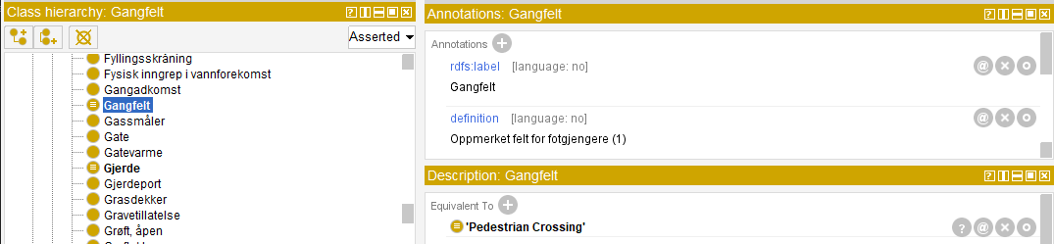
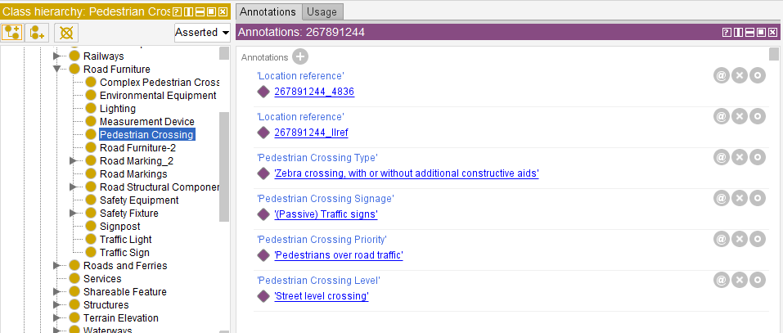
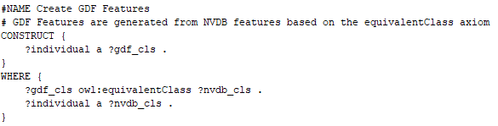
Example LinkSet: NVDB → GDF
NVDB
GDF
SPARQL
Result

Slide 53
SRQ4: A joint modelling approach
“How can information models and semantics for implementation technologies for GIS, ITS and BIM be integrated into a joint modelling approach?”
Jetlund, K. (2021). Harmonizing and linking conceptual models of geospatial information. Faculty of Engineering, Department of Manufacturing and Civil Engineering, Norwegian University of Science and Technology. PhD: 207.
Notes:
Finally, we have come to SRQ4, which concerned a joint modelling approach for the three application domains.
As we can see from this illustration of the five SRQs, results from the four other SRQs served as input to SRQ4. That’s the reason why I presented question five before number four.
The results from SRQ1 identified the GIS approach based on ISO/TC 211 standards as the most complete approach for information modelling.
The results from SRQ2 showed that information models for the exchange of information from GIS to ITS, including the GDF feature catalogue, could be based on the GIS MDA approach.
Likewise, the results from SRQ3 showed that the IFC specification for BIM could be transformed into the GIS MDA approach.
And finally, the results from SRQ5 showed that conversions from UML to OWL could be improved by adding more semantics and rules to the GIS approach.

Slide 54
Jetlund, K. (2021). Harmonizing and linking conceptual models of geospatial information. Faculty of Engineering, Department of Manufacturing and Civil Engineering, Norwegian University of Science and Technology. PhD: 207.
Prototype experiment:
A structure of UML Profiles for GIS, ITS and BIM
Notes:
The findings on the use of UML and MDA from the other SRQs served as input to a prototype experiment with a structure of UML profiles for information modelling in the three application domains. The structure was based on a framework originally developed by Kutzner in 2016, and adapted to fit the findings and the scope in this thesis.
The structure contains four levels of profiles, connected through package merge relations:
The base profile and the community conceptual profiles define general and community-specific concepts for Platform-Independent Models.
The general and community encoding profiles defines general and community-specific semantics for Platform-Specific Models.

Slide 55
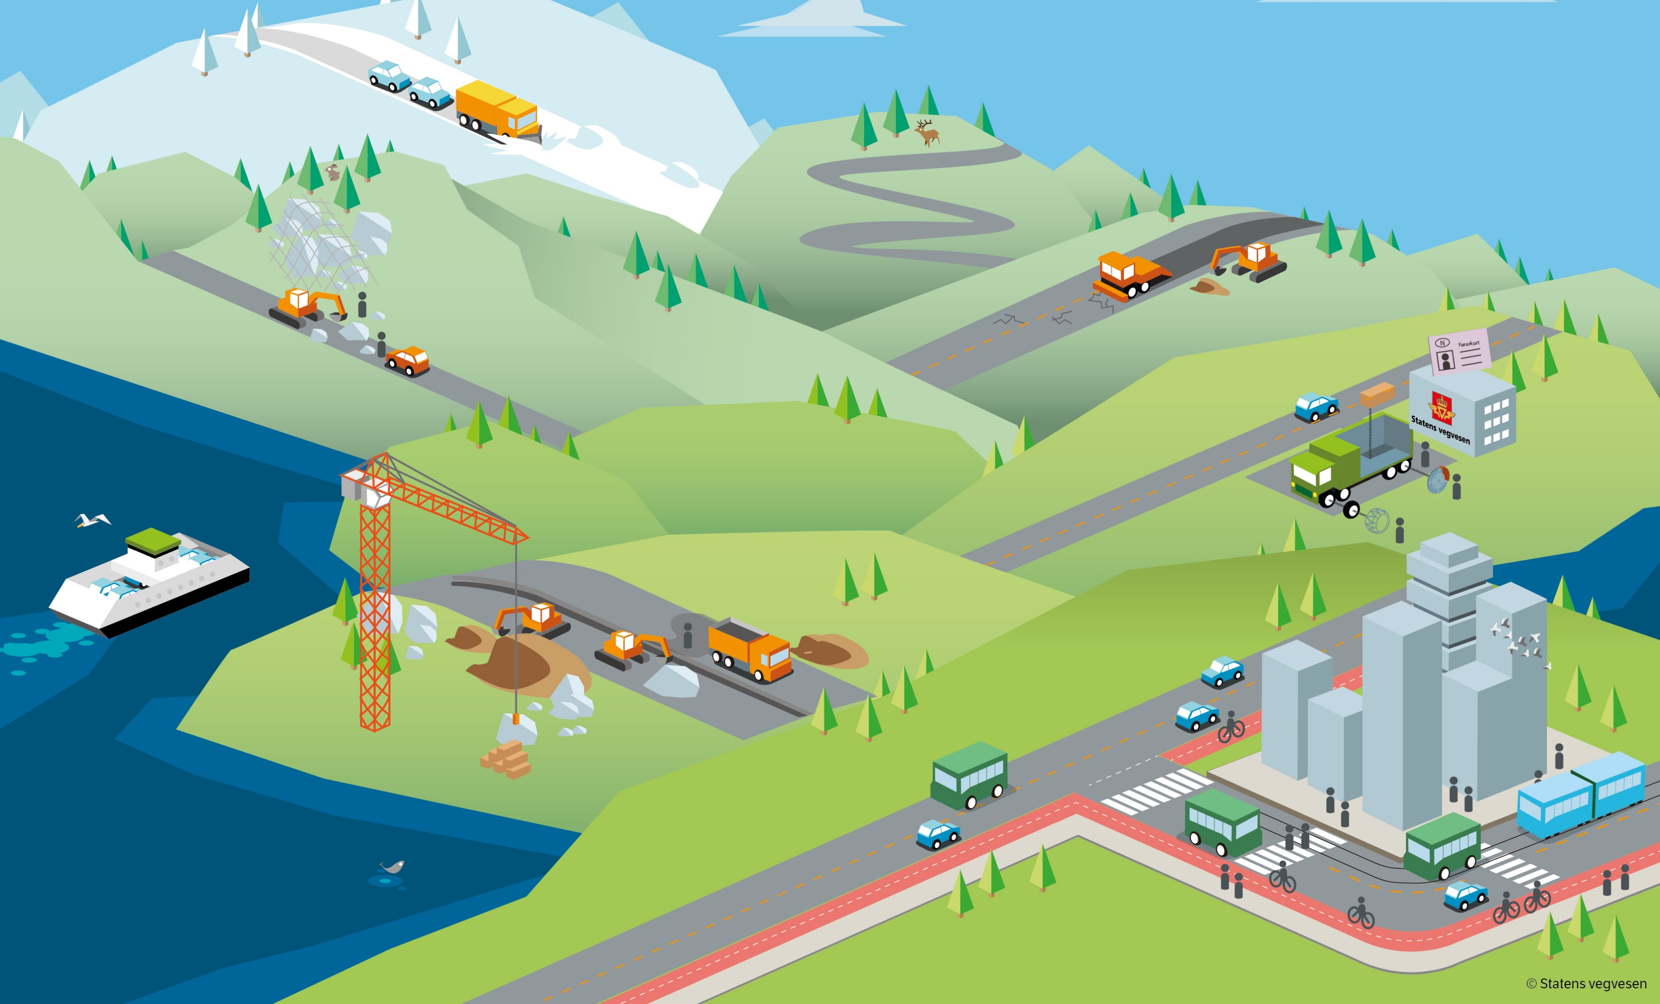
Conclusions and summary
Illustration: Martin Blystad, Statens vegvesen

Slide 56
Conclusions - main contribution
A joint approach for information modelling in UML
Prototypes for UML profiles and models within the harmonized approach
Improved syntactic and semantic interoperability
Notes:
The most important outcome of the research presented in this thesis was the development and testing of the joint, harmonized approach for modelling geospatial information in the three application domains, founded on MDA and a structure of UML profiles.
Furthermore, prototypes of the core information models IFC for BIM, and GDF for ITS, showed that models for BIM and ITS could be transformed into a joint approach.
By describing all prototype models and metamodels in the same conceptual schema language, based on a joint modelling approach and with common core concepts, the research showed that improved syntactic and semantic interoperability between GIS, ITS and BIM could be achieved.

Slide 57
Conclusions
Full harmonization not appropriate
Apply LinkSets for mapping
Apply the joint modelling approach for all three domains
Use common core concepts
Data types from non-domain-specific models
Common concepts for geometry and location referencing
Photo: Knut Opeide, Statens vegvesen
Notes:
The research indicated that a full harmonization would not be the best solution for optimized use in each application domain. The three application domains have different roles in the digital geospatial environment and need to describe features from the real world in different contexts, with different representations.
Therefore, further improvements of the semantic interoperability must be achieved by applying Linksets based on Semantic Web technologies for linking and mapping of heterogeneous information models. For this purpose, the research showed that conversions from UML to OWL could be improved, but must be configured according to the level of information flow.
Even though the models cannot be wholly harmonized, they should be as harmonized as possible. Any transformation leads to a loss of information, and models that are based on the same modelling approach and use the same core concepts are more similar, and fewer transformations are needed.
Therefore, the joint modelling approach should be applied, and common, core concepts should be used as far as possible. In particular, general concepts for core datatypes should be used in all domains, and common concepts for geometry and location referencing should be established and used.

Slide 58
Summary
Many digital representations
Ecosystem of digital twins
Open and Closed World Assumptions
Pros and cons – depending on the use case
Syntactic interoperability by translation
Neither UML nor OWL is perfect
Semantic interoperability is more complicated
Modular standards based on an MDA are fit for implementation i various domains and technologies
Use common models as far as possible!

Slide 59
Similar representations
Tobler’s first law of geography (Tobler, 1970):
“everything is related to everything else, but near things are more related than distant things”.
Modernized to a digital world with multiple representations of the same physical ”thing”:
“every digital representation of a thing can be linked to any other digital representation of the same thing, but links between similar representations are more precise than links between dissimilar representations”.
Jetlund, K. (2021). Harmonizing and linking conceptual models of geospatial information. Faculty of Engineering, Department of Manufacturing and Civil Engineering, Norwegian University of Science and Technology. PhD: 207.
Notes:
52 years ago, the geographer Waldo R Tobler defined his first law of geography as
“everything is related to everything else, but near things are more related than distant things”.
Following the conclusions from the previous slide, Tobler’s first law can be modernized into a digital world with multiple representations of real-world things, saying that
“every digital representation of a thing can be linked to any other digital representation of the same thing, but links between similar representations are more precise than links between dissimilar representations”.
In other words; we should strive towards digital representations that are as similar as possible.

Slide 60
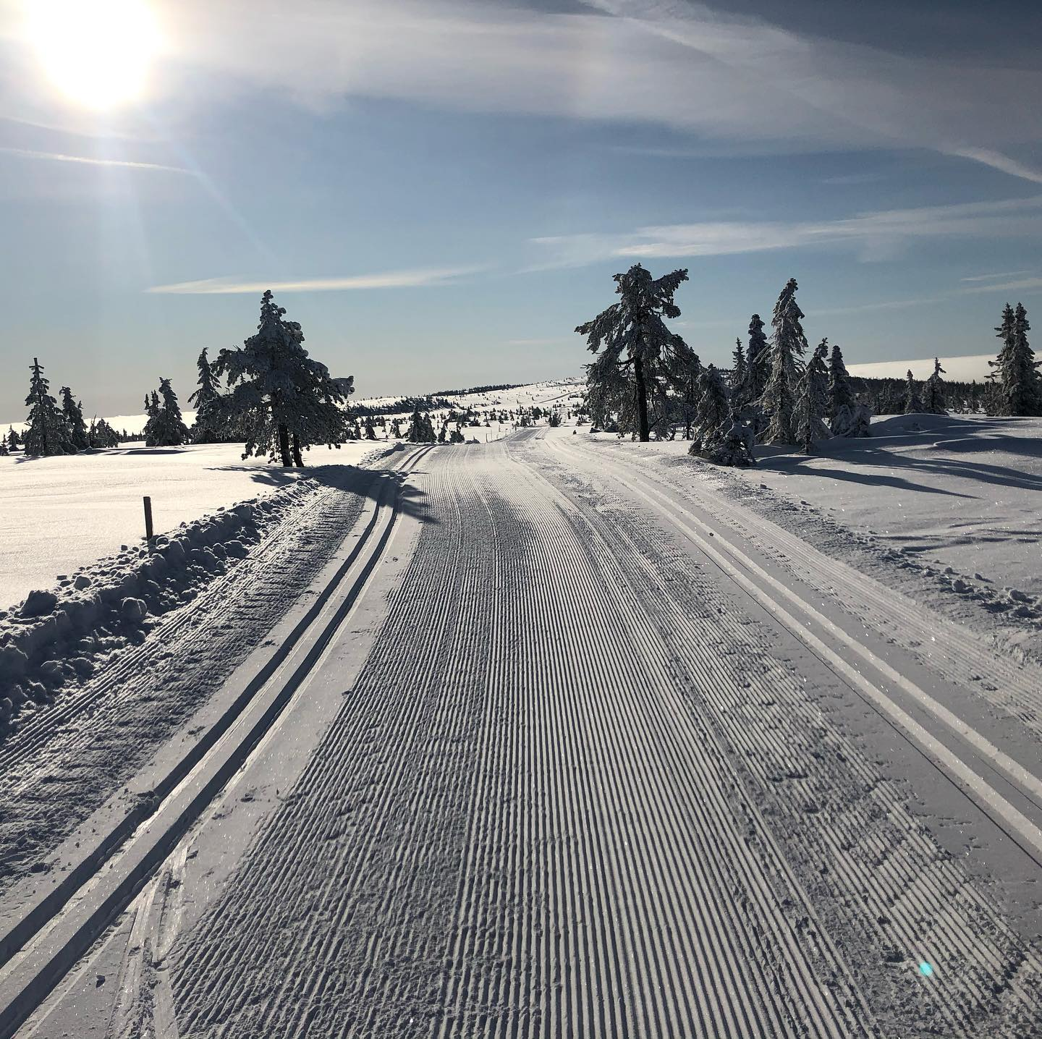
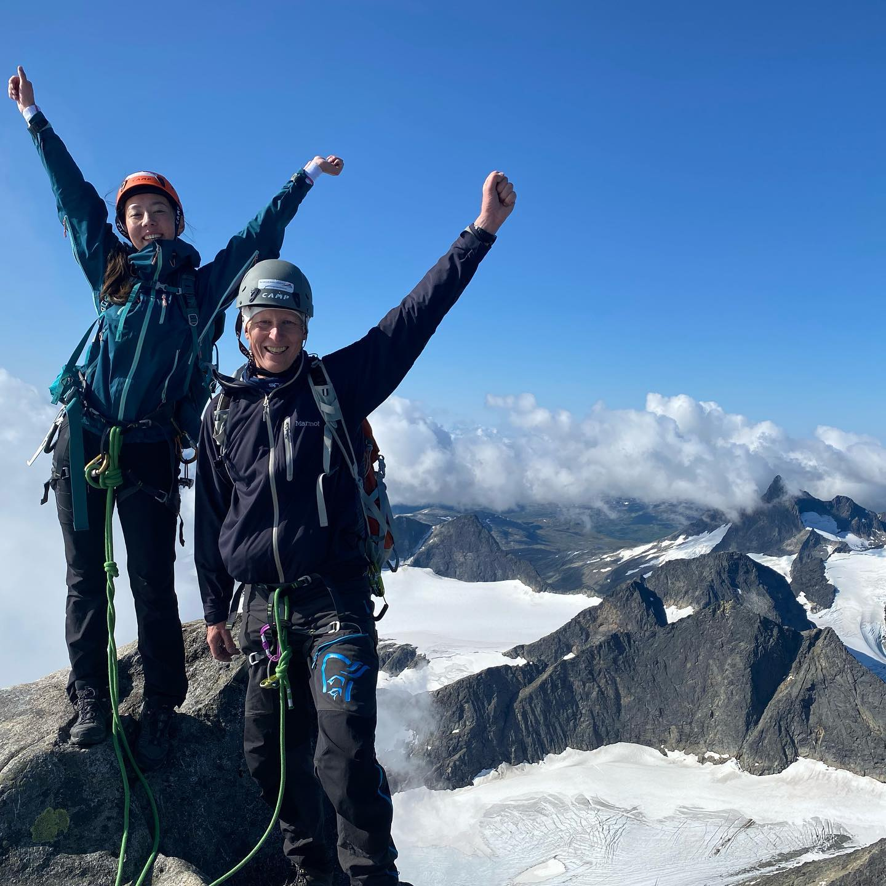
Thanks for listening!
Knut Jetlund
Norwegian Public Roads Administration
Norwegian University of Science and Technology
ISO/TC 211 AG 5 – HMMG
knut.jetlund@vegvesen.no
Twitter: @Jetgeo
LinkedIn: https://www.linkedin.com/in/knut-jetlund/

